Slide 1
What data can tell us about sex and relationships
Professor Chris Callison-Burch

Slide 2
Stanford Speed Dating Experiment
Linguists at Stanford University got permission to record speed dates, and collect pre-date and post-date surveys
Participants wore audio recorders on shoulder sashes
Recorded 2 sides of the conversations for 1100 4-minute dates
Notes:
Paper title: It’s Not You, it’s Me: Detecting Flirting and its Misperception in Speed-Dates
Rajesh Ranganath, Dan Jurafsky, Dan McFarland

Slide 3
Pre-date survey
Participants self-reported age, height and weight, hobbies and interests, dating background

Slide 4
Post-date survey
Date perceptions and follow-up interest
Conversational style and intention of their partners
Notes:
They focus on flirtation in speed-dating.
difference between perception and intention.
intention = meaning intended by the speaker
perception = meaning perceived by the hearer

Slide 5
Speed date data
4-minute sound recording files from each recorder
Each date was then transcribed
Transcripts marked words, laughter, filled pauses, speaker overlap, and restarts
Timestamped the beginning and end of each conversational turn
Dates averaged 812 words (406 per speaker), taking an average of 93 turns

Slide 6
F: | Well what about you, what are you passionate about?
M: | Um, I am passionate about probably two things.
F: | Uh-huh.
M: | Well, many things, but two that come to mind straightaway. One is travel.
F: | Okay.
M: | I like see different parts of the world-
F: | Uh-huh.
M: | -experience lots of different things. And I also- recently, I’ve got into exercise, and, um, just different things, so riding a bike, and swimming, and running.
F: | Oh, okay. Uh-huh.
M: | I did my first track run on the weekend.
F: | Oh, you did? How was it?
M: | It was hard.
F: | [laughter] Yeah, I heard it’s really hard.

Slide 7
Prediction tasks
Build a machine learning classifier to identify friendly, flirtatious, awkward, or assertive speakers
Build separate classifiers for detecting when characteristics were self-reported or reported by partners
Build separate classifiers for men and women
4 characteristics * self-v-partner * 2 sexes = 16 classifiers (e. g. male self-reported flirtation classifier)

Slide 8
Feature extraction
Features of the speech files: pitch, intensity, turn duration and rate of speech (num words per second)
Lexical features: how often they mentioned themselves or the other person, word categories like sex, love, hate, food, swearing
Number of uh and ums, hedges, interruptions, laughters, agreements, questions, expressions of agreement, appreciation, sympathy
Rate of accommodation (adopting the other person’s word usage)

Slide 9
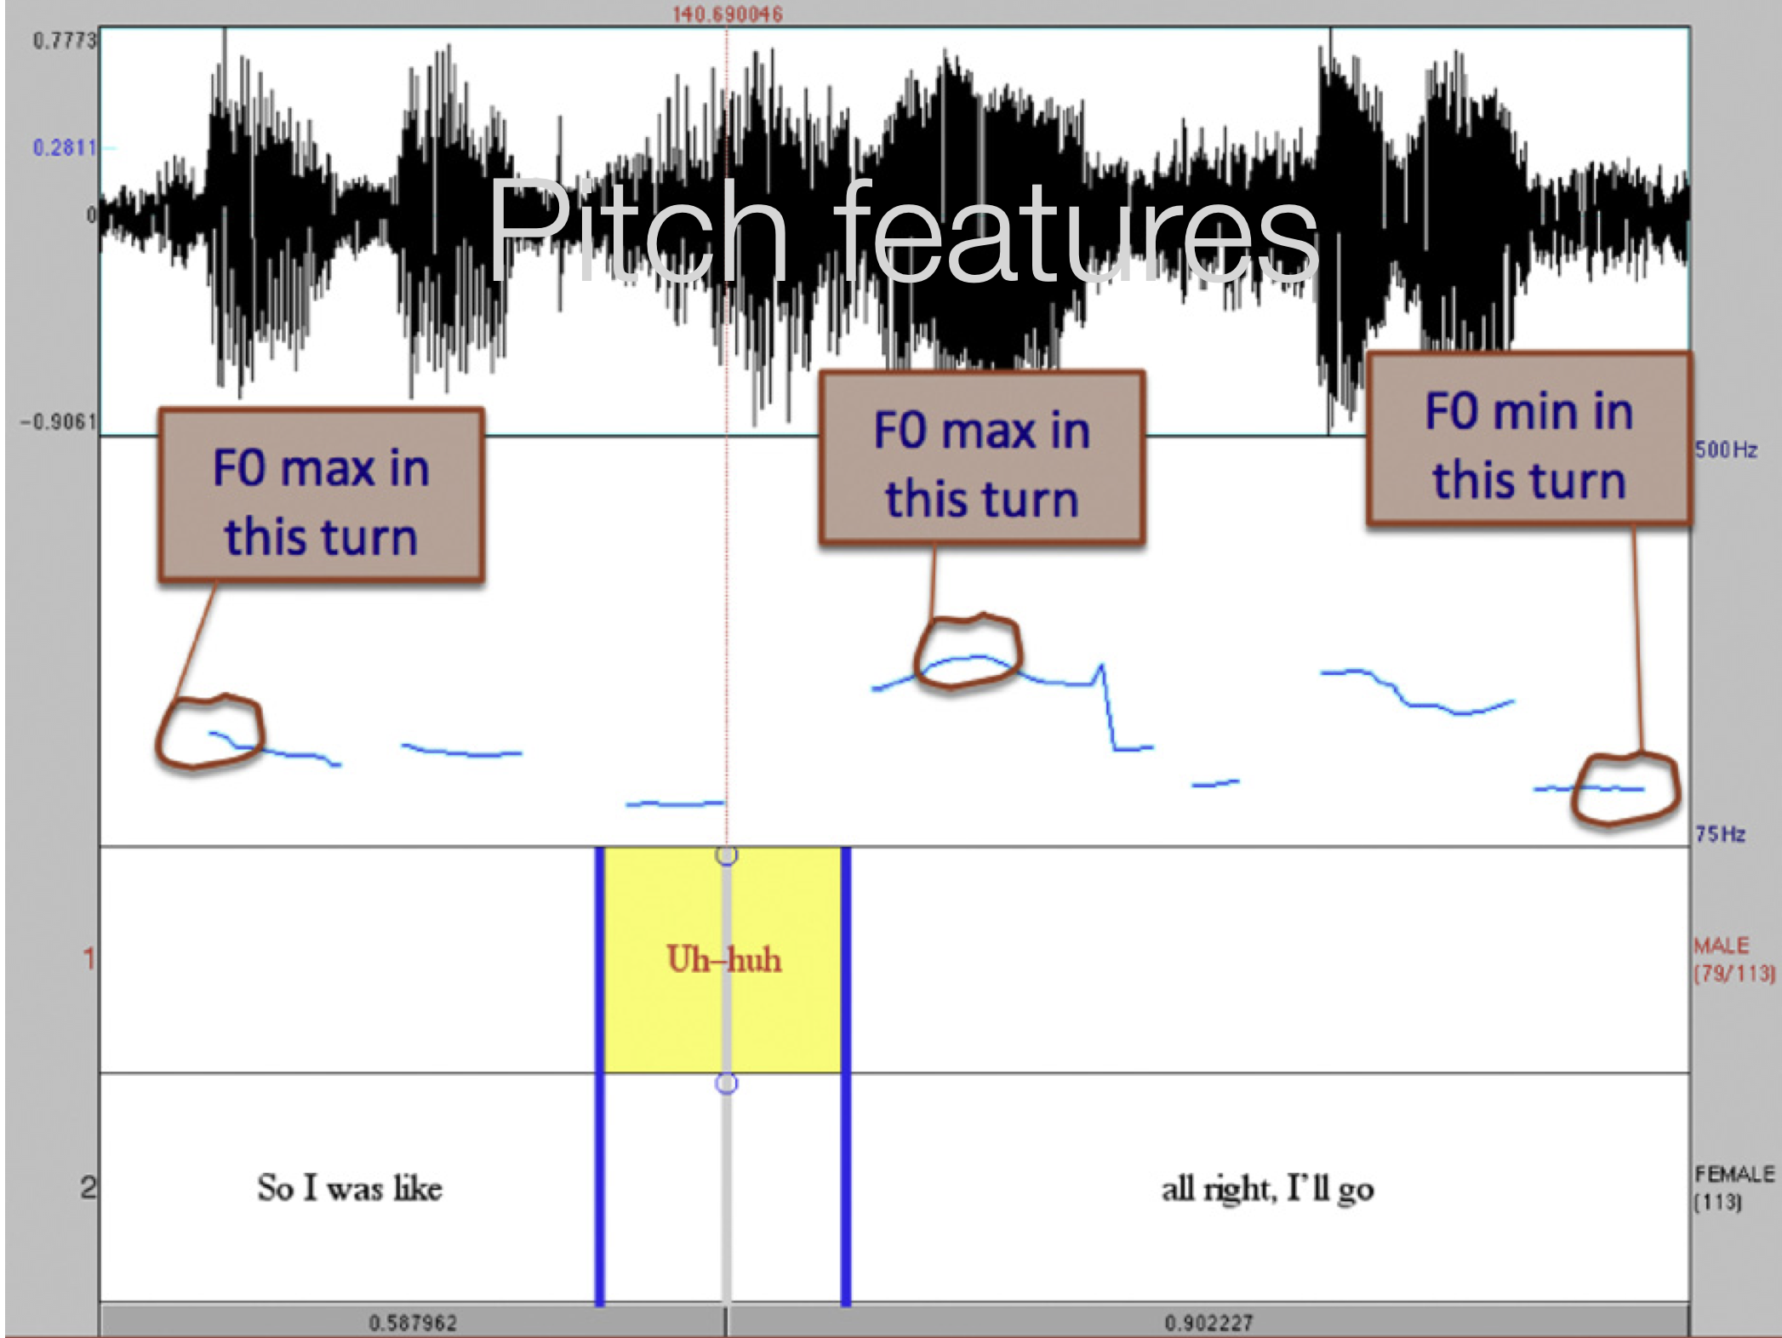

Slide 10
Lexical Features
I | I’d, I’ll, I’m, I’ve, me, mine, my, myself
YOU | you, you’d, you’ll, your, you’re, yours, you’ve
SEX | sex, sexy, sexual, stripper, lover, kissed, kissing
LOVE | love, loved, loving, passion, passions, passionate
HATE | hate, hates, hated
SWEAR | suck*, hell*, crap*, shit*, screw*, damn*, heck, ass*,. . .
NEG EMO | bad, weird, crazy, problem*, tough, awkward, worry,. . .
NEGATE | don’t, not, no, didn’t, never, haven’t, can’t, wouldn’t,. . .
FOOD | food, eat*, cook*, dinner, restaurant, coffee, chocolate, cookies,. . .
DRINK | party, bar*, drink*, wine*, beer*, drunk, alcohol*, cocktail,. . .
ACADEMICS | work*, program, PhD, research, professor*, advisor, finish*,. . .

Slide 11
Lexical Features
HEDGE | sort of, kind of, I guess, I think, a little, maybe, possibly, probably
META | speed date, flirt, event, dating, rating
LIKE | the discourse marker like (removing the verb like)
I MEAN | the discourse marker I mean
YOU KNOW | the discourse marker you know
UH | the filled pause uh
UM | the filled pause um

Slide 12
Discourse Features
TOTAL WORDS | total number of words in side
QUESTIONS | number of questions in side, clarification question (Excuse me?) number of turns in side which one speaker interrupted the other number of instances of turn-initial or whole-turn laughter in side number of instances of turn-medial or turn-final laughter in side total number of disfluent restarts in conversation side
CLARIFICATIONS | clarification question (Excuse me?)
INTERRUPTIONS | number turns one speaker interrupted the other
LAUGH INITIAL | number of turn-initial or whole-turn laughter
LAUGH MEDIAL | number of turn-medial or turn-final laughter
RESTART | num disfluent restarts in conversation side
APPRECAITIONS | num appreciations (Wow, That’s true, Great) great)
SYMPATHY | number of sympathetic negative assessments in side
AGREEMENT | num of agreements (That’s true, For sure. . .)

Slide 13
Classification
Trained a Support Vector Machine for each of the 16 experiments
For training data, took top 10% of data as positive training examples and bottom 10% of data as negative data
For example, for self-reported male flirtation, sort all 1000 dates by self-reported male flirtation score take top 100 and bottom 100
Since training data was small, did 4 fold cross validation, 30x times w/random order
Notes:
This yields a data split with 80% of the data in the training set and 20% in the test set. Each fold was split 50/50 between the positive and negative class. To help ensure that we learned features that were general, particularly given the small size of our datasets, we randomized our data ordering and repeated the test 30 times.

Slide 14
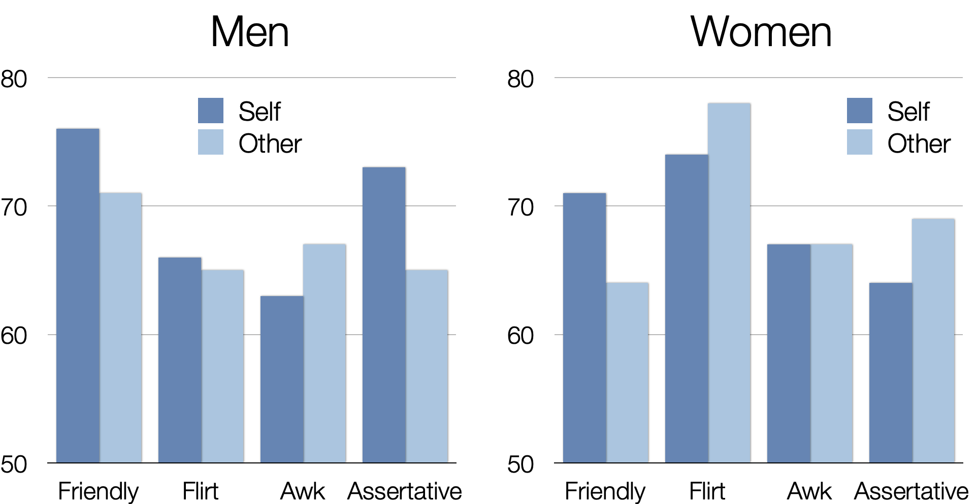
Classification Accuracy

Slide 15
Notes:
Feature weights for flirtation detection in decile study (median weights of the randomized runs) for the non-zero predictors for each classifier. Boldfaced features hold across self and other ratings, and boldfaced features that were also significant in the quartile study are underlined.

Slide 17
Linguistic v. non-linguistic features
How good are the linguistic features compared to non-linguistic features?
Can we predict how well two people will hit it off just based on their appearance or on their shared interests, without observing their interactions?

Slide 18
Non-linguistic Features
ORDER | Order of the date (nth date the speaker has participated in tonight)
HEIGHT | The height of the speaker
BMI | The body mass index of the speaker
O-HEIGHT | The height of the interlocutor
O-BMI | The BMI of the interlocutor
AGE DIFF | The age difference between the pair
INTEREST SIM | The interest similarity between the pair

Slide 19
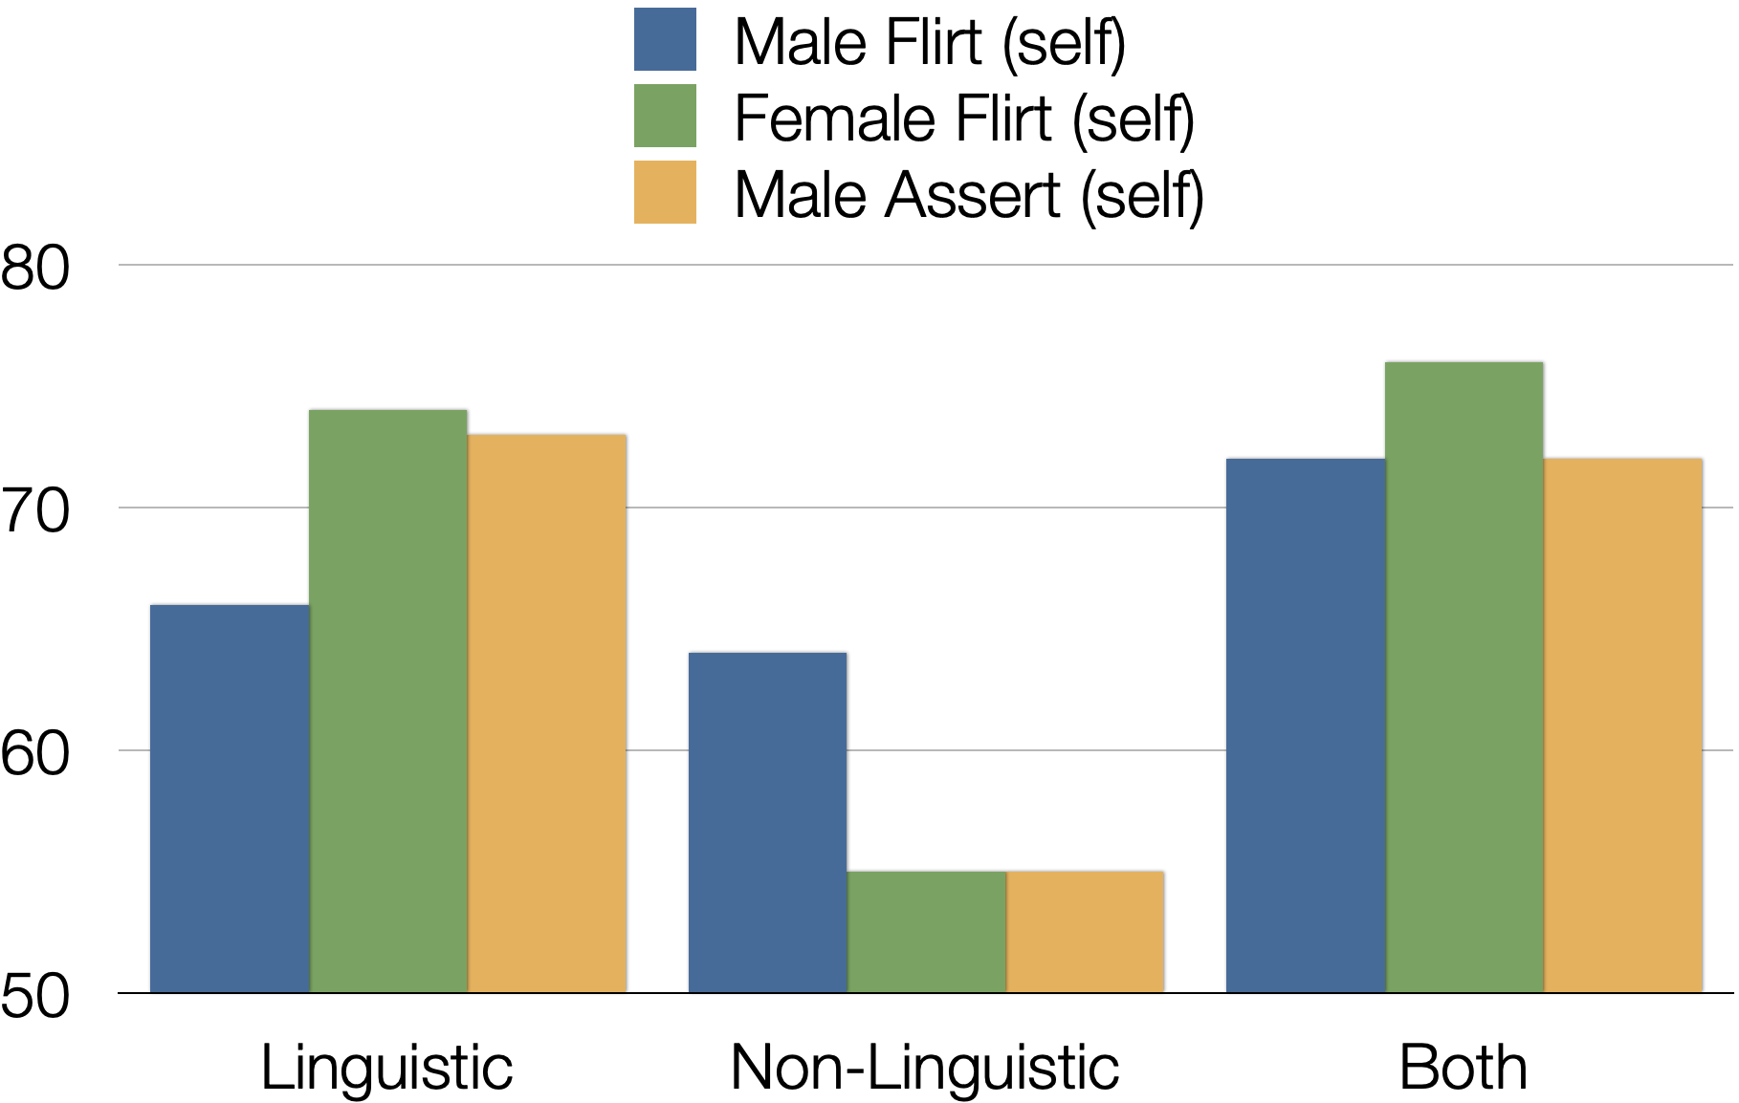
Classification Accuracy
Notes:
Our analysis shows that humans are very poor perceivers of intended flirtatiousness, instead often projecting their own intended behavior onto their interlocutors.

Slide 20
What do you think?
Do you think that the SVM’s accuracy is better or worse than a person’s accuracy at predicting whether someone is flirting with them?
Do you think that 4 minutes of data is sufficient for making accurate predictions?
Any methodological concerns?
Could you use data to change your own dating strategies?
Notes:
Our flirtation- detection system uses prosodic, dialogue, and lexical features to detect a speaker’s intent to flirt with up to 71.5% accuracy, significantly outperforming the baseline, but also outperforming the human interlocuters. Our system addresses lexical feature sparsity given the small amount of training data by using an autoencoder net- work to map sparse lexical feature vectors into 30 compressed features. Our analy- sis shows that humans are very poor per- ceivers of intended flirtatiousness, instead often projecting their own intended behavior onto their interlocutors.

Slide 21
Data-driven Sociological Studies
3.2 million OKCupid users
Profile information: age, gender, sexual orientation, location, ethnicity, religion, level of education, income level, height, body type, whether you like kids/pets/drinking/drugs, essays, profile pictures plus attractiveness ratings
Database of 275,294 match questions
776 million answers to those questions
Notes:
ccb - todo - reactivate accounts and show screens of example questions

Slide 22
What's more interesting to you right now? Love or Sex
How willing are you to meet someone from OkCupid in person?
Have you smoked a cigarette in the last 6 months?
Could you date someone who does drugs?
Would you strongly prefer to go out with someone of your own skin color / racial background?
About how long do you want your next relationship to last?
Would you consider sleeping with someone on the first date?
Are you happy with your life?
Rate your self-confidence
How important is religion/God in your life?
Would you prefer good things happened, or interesting things?
Do you like horror movies?

Slide 23
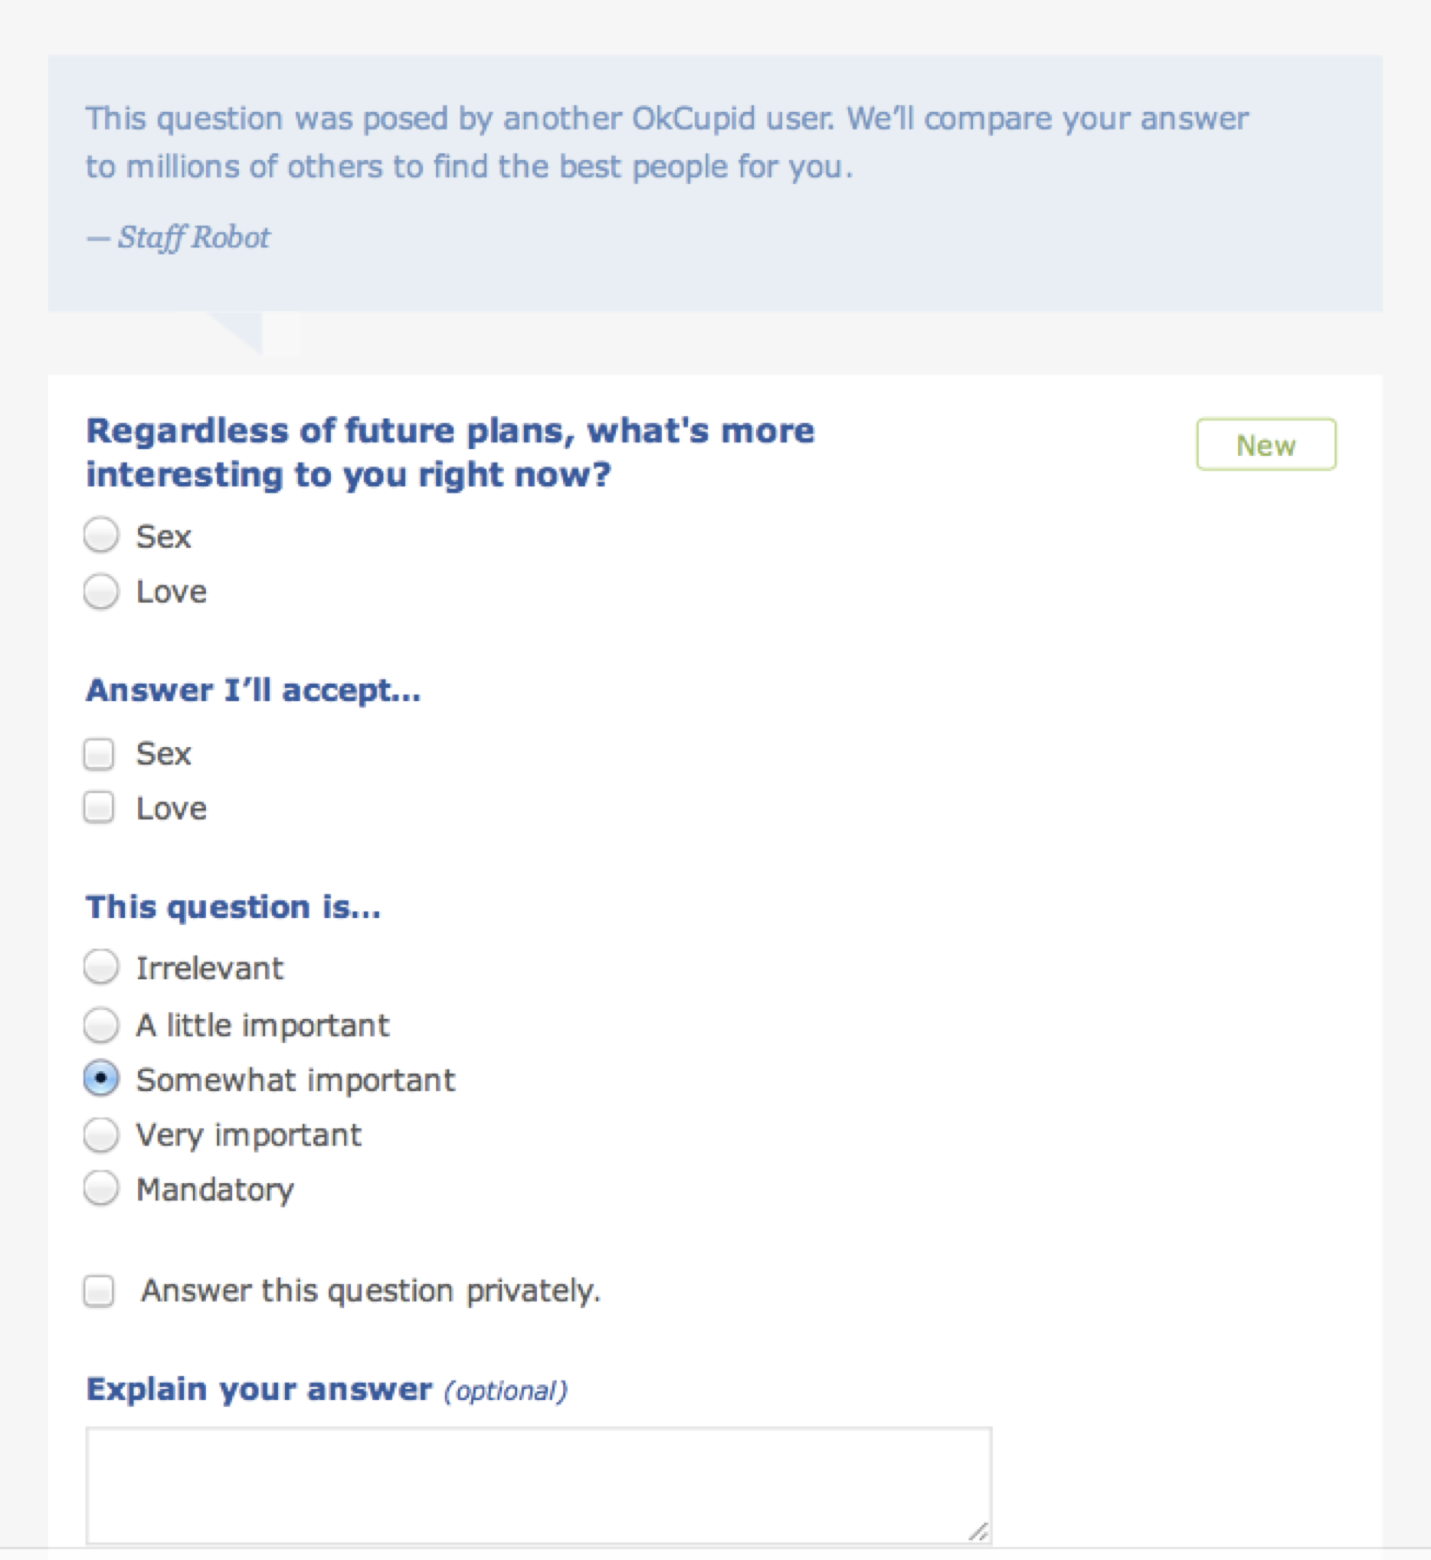

Slide 24
The Best Questions on a First Date
You would like to learn about your date, some important things that you would like to know are awkward to ask directly
Find questions that correlate with what you want to know, but which people are more free about answering publicly

Slide 25
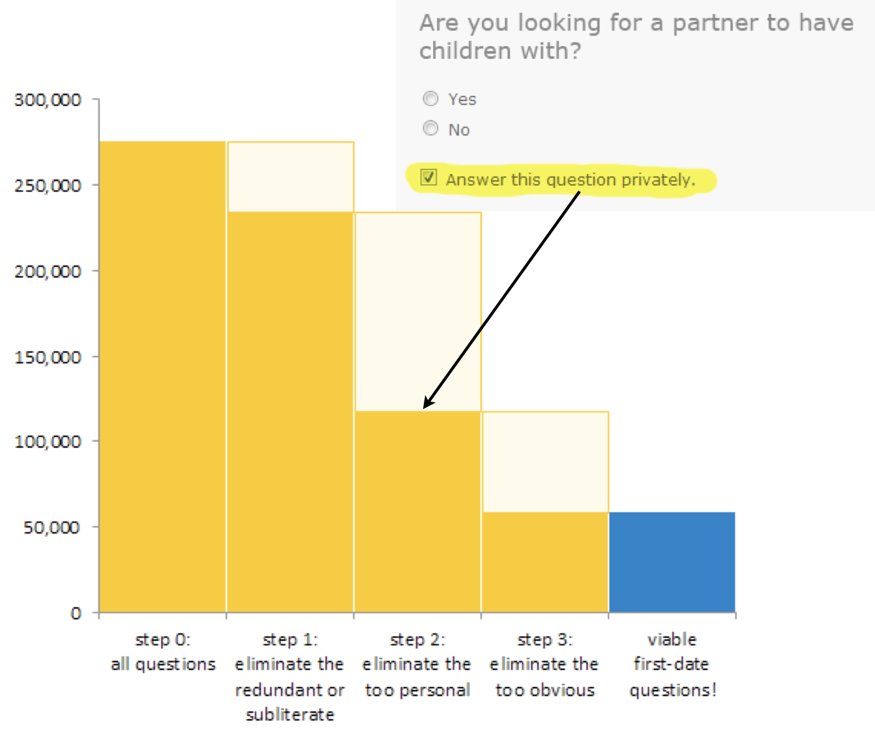

Slide 26
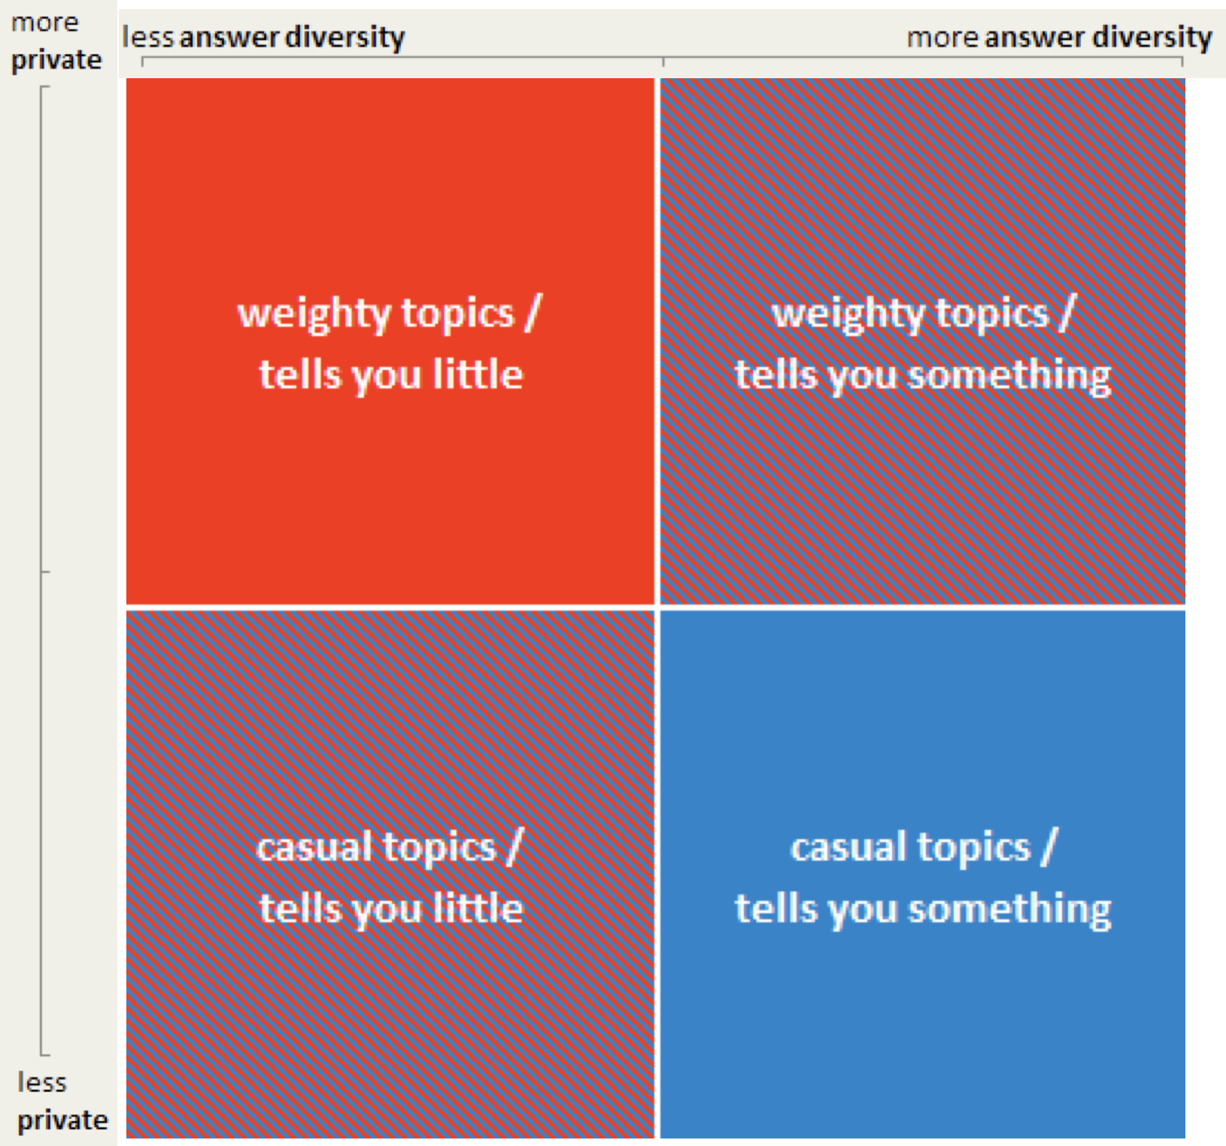

Slide 27
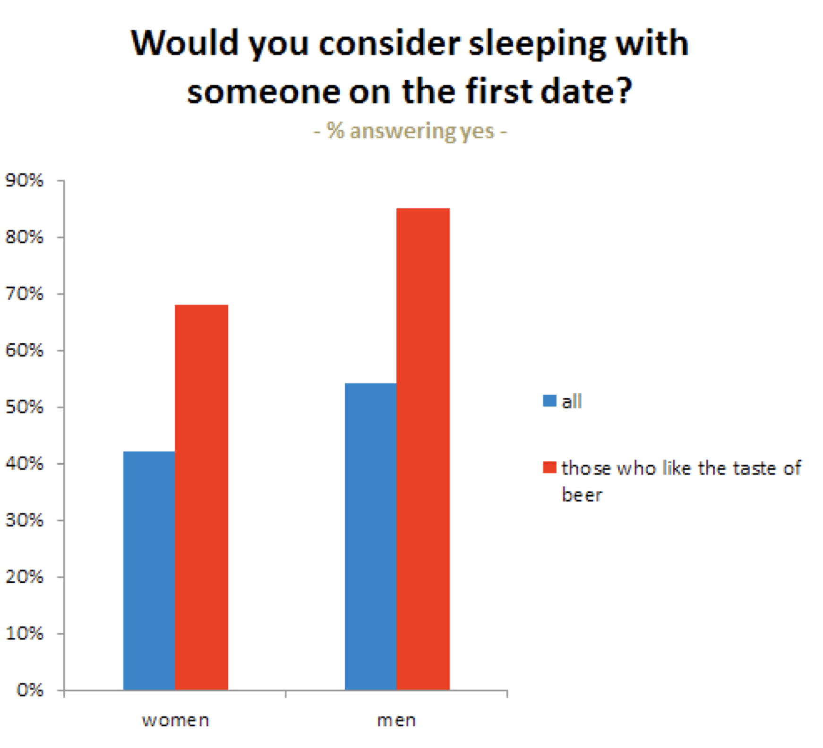

Slide 28
Other questions to ask
predictive question | implied odds of first-date sex
Q: In a certain light, wouldn't nuclear war be exciting? | yes –> 83%
Q: Assuming you were in the position to do so, would you launch nuclear weapons under any circumstances? | yes –> 82%
Q: Could you imagine yourself killing someone? | yes –> 82%

Slide 29
LTRs
If you’re interested in a long term relationship, you can use this methodology too
When someone deletes their OkCupid account, the option of giving a reason
One is 'I met somebody on OkCupid,' they can report their significant other's username
34,000 such pairs exist

Slide 30
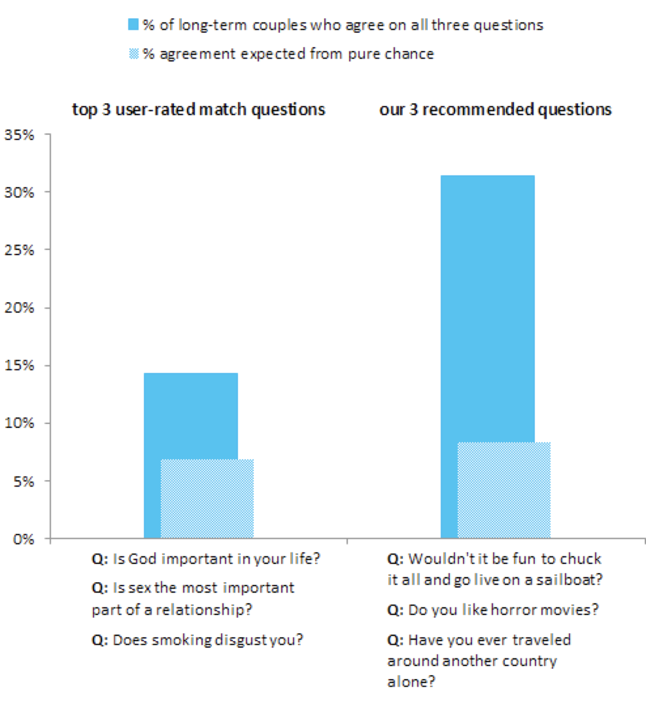


Slide 31
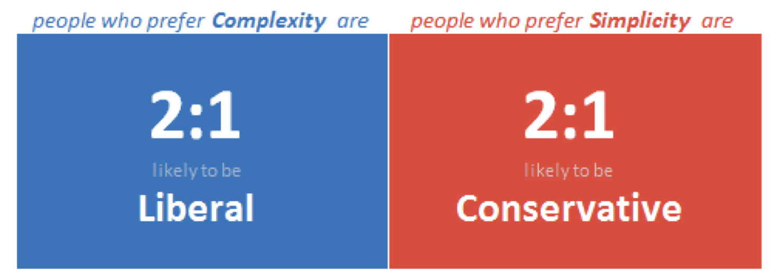
Politics
If you want to know: Do my date and I have the same politics?
Ask: Do you prefer the people in your life to be simple or complex?

Slide 32
Politics
People who prefer complexity are 65-70% likely to give the Liberal answer. Those who prefer simplicity in others are 65-70% likely to give the Conservative one:
Should burning your country's flag be illegal?
Should the death penalty be abolished?
Should gay marriage be legal?
Should Evolution and Creationism be taught side-by-side in schools?

Slide 33
Religion
If you want to know: Is my date religious?
Ask: Do spelling and grammar mistakes annoy you?
If your date is okay with bad grammar and spelling then the odds of him or her being at least moderately religious is slightly better than 2:1

Slide 34
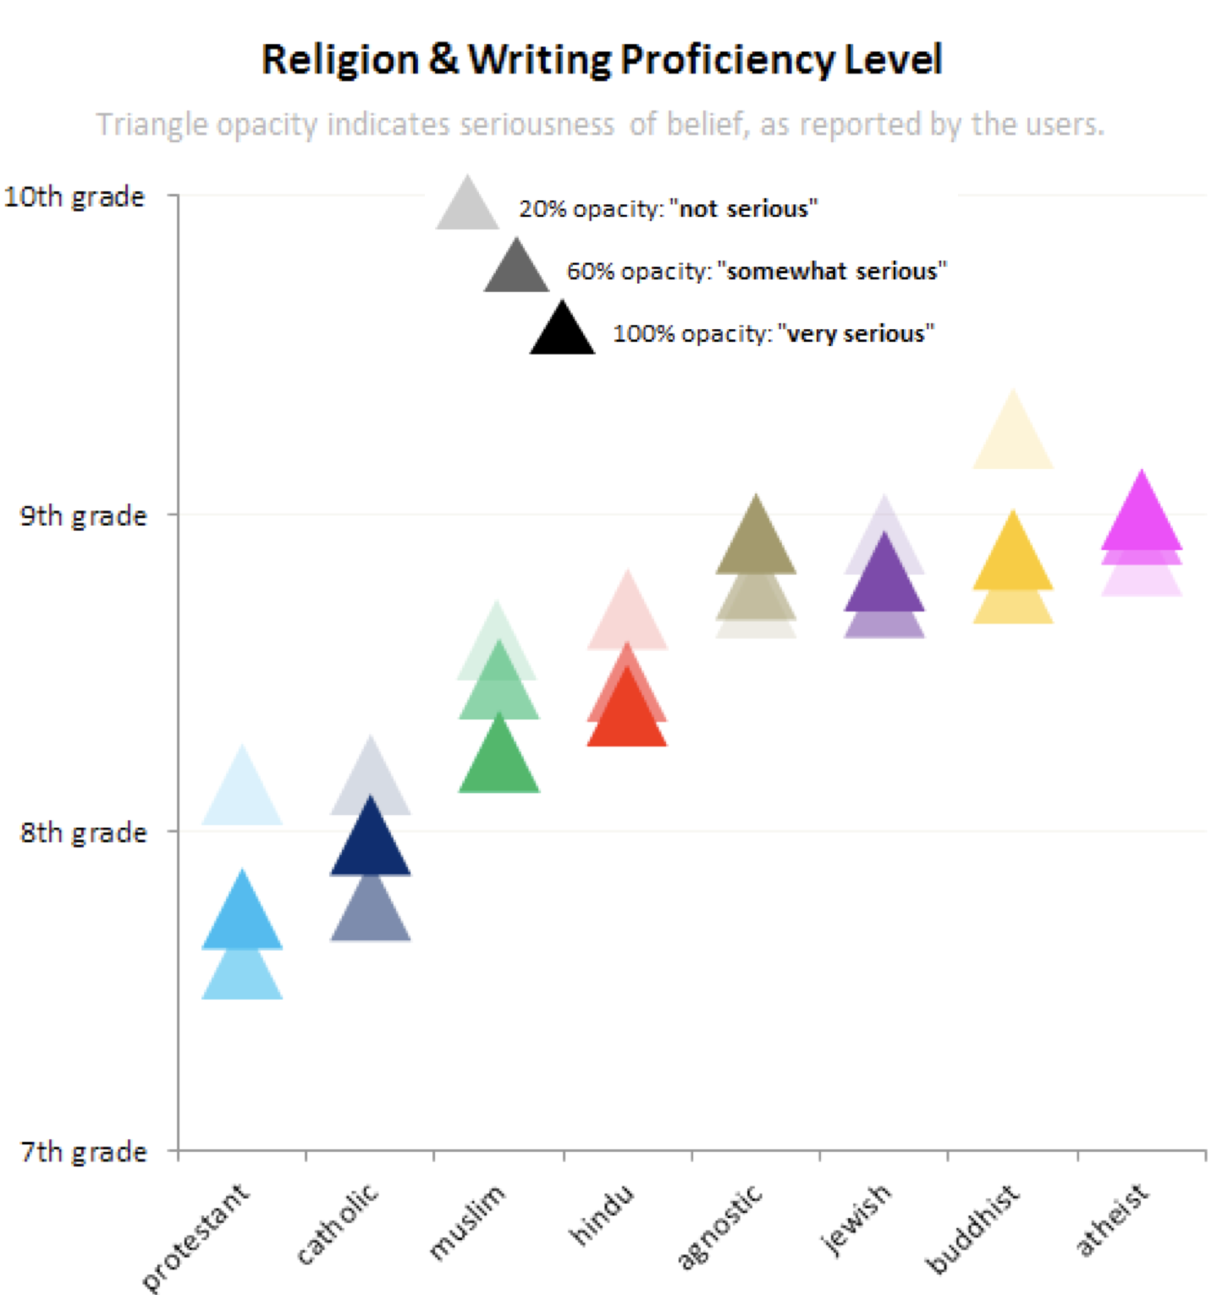

Slide 35
Ethnicity
What is it that makes a culture unique? How are whites, blacks, Asians, or whoever different from everybody else? What tastes, interests, and concepts define an ethnic group?
Analyzed 500,000+ profiles with self reported race, looking at 280M words worth of profile essays
Analyze words that are statistically distinct from other racial groups (everyone likes sushi, only Asians list sashimi).

Slide 36
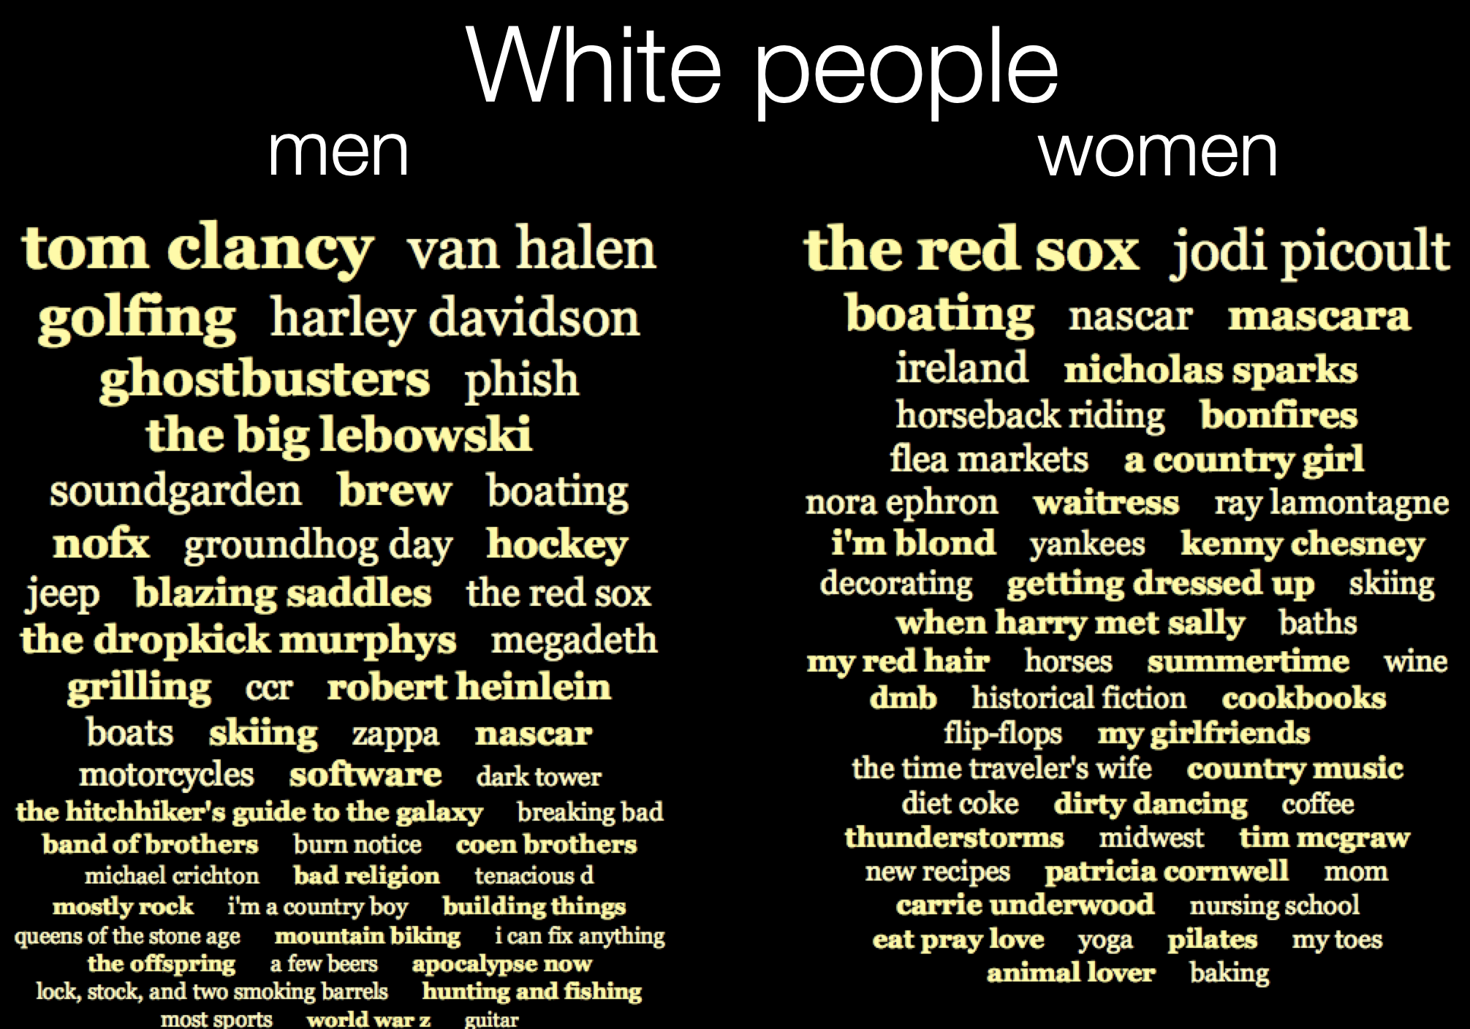

Slide 37
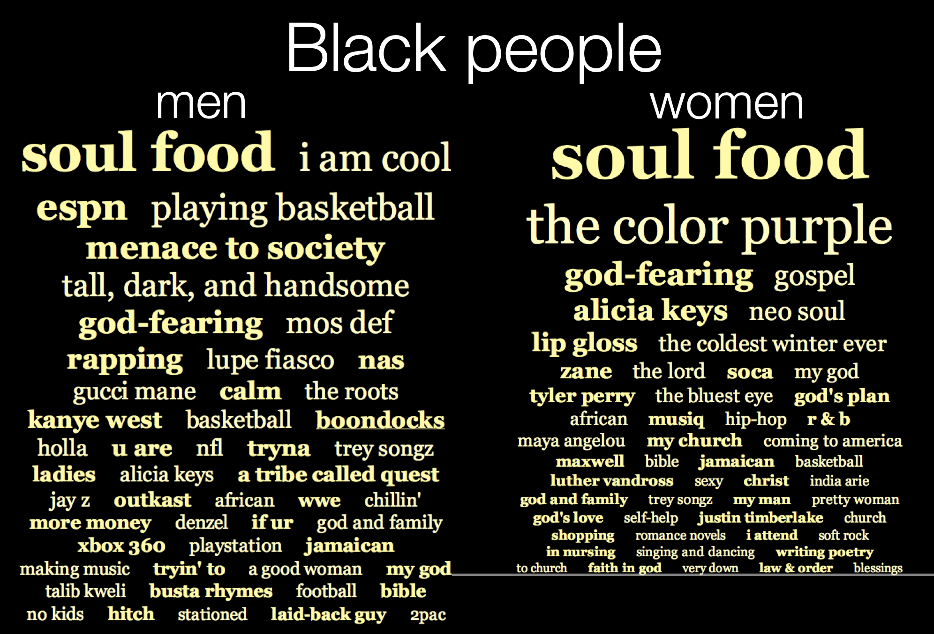

Slide 38
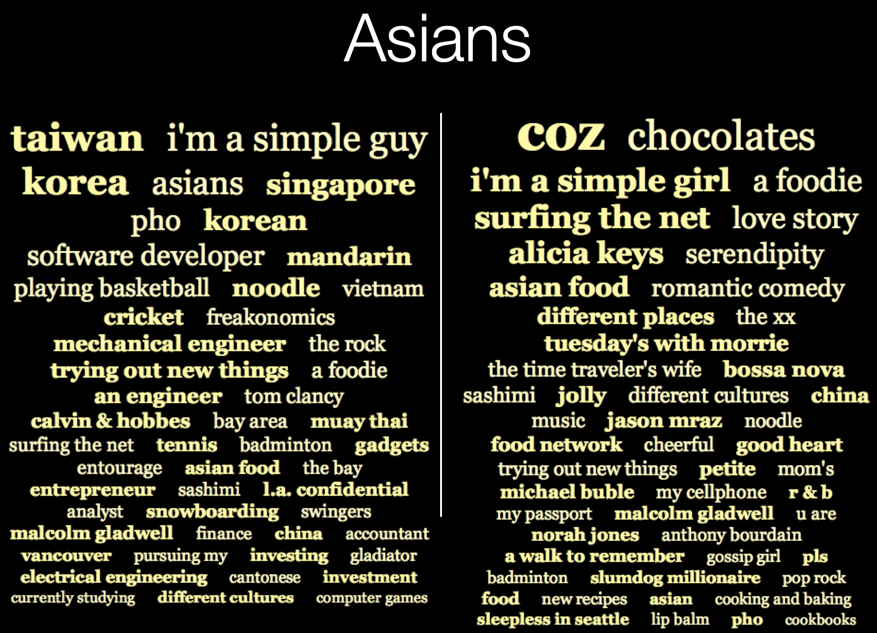

Slide 39
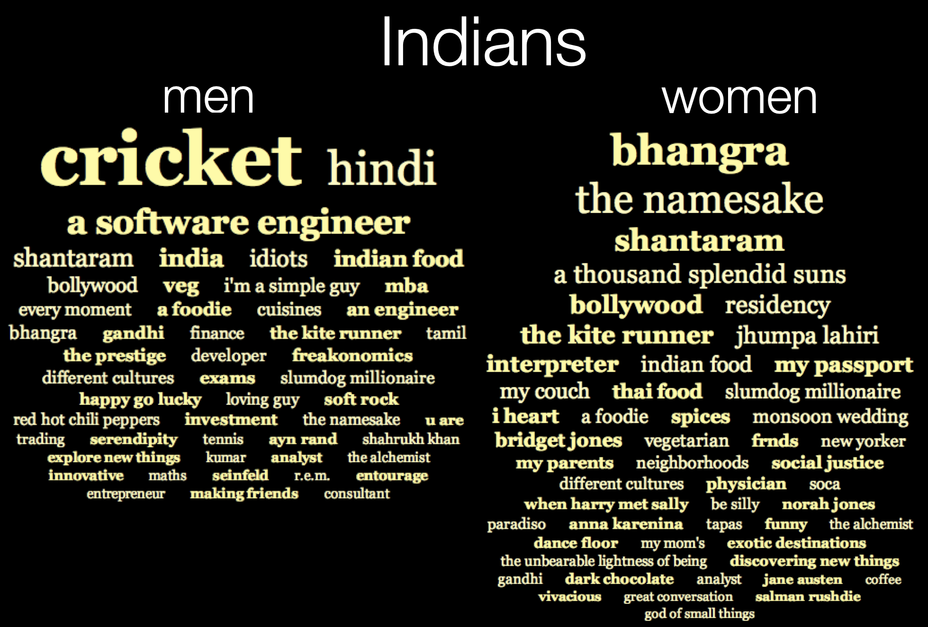

Slide 40
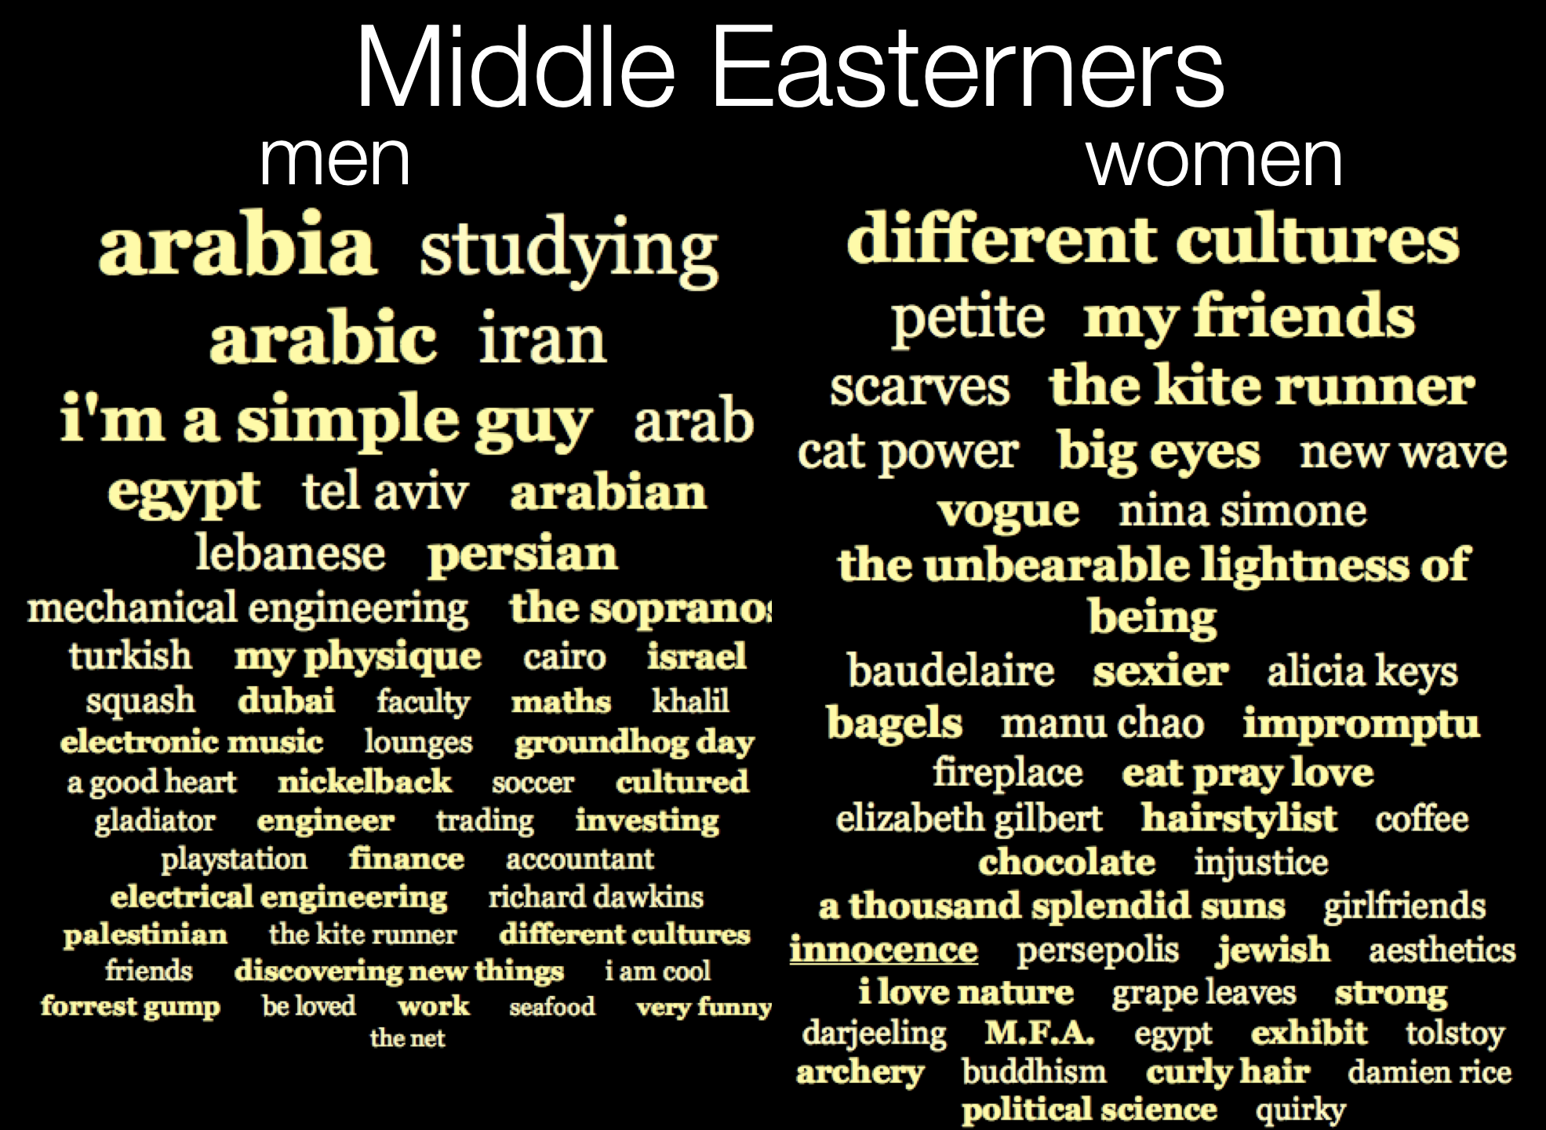
Notes:
As you can see, the races all match each other roughly evenly: good news.

Slide 41
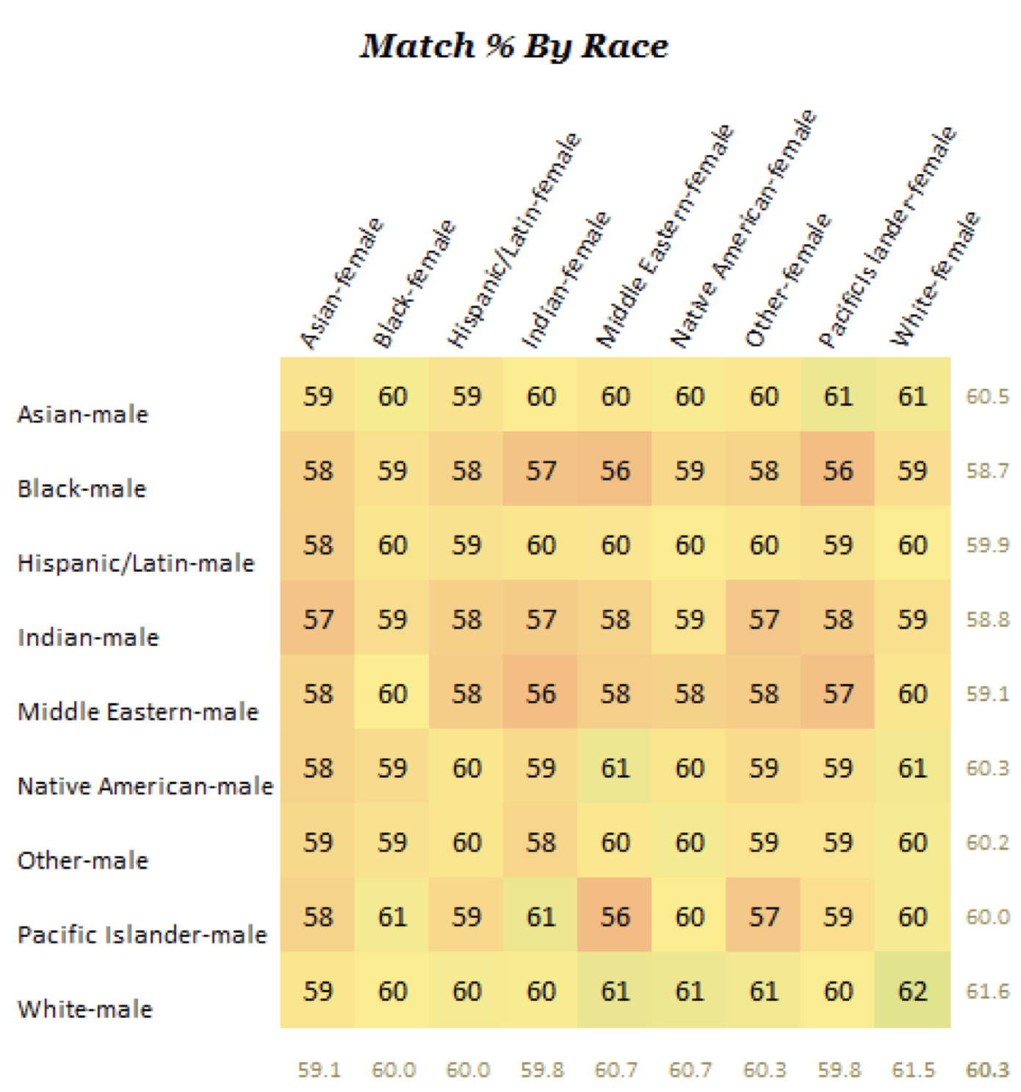
Notes:
Black women write back the most
White men get more responses
White women prefer white men to the exclusion of everyone else—and Asian and Hispanic women prefer them even more exclusively.

Slide 42
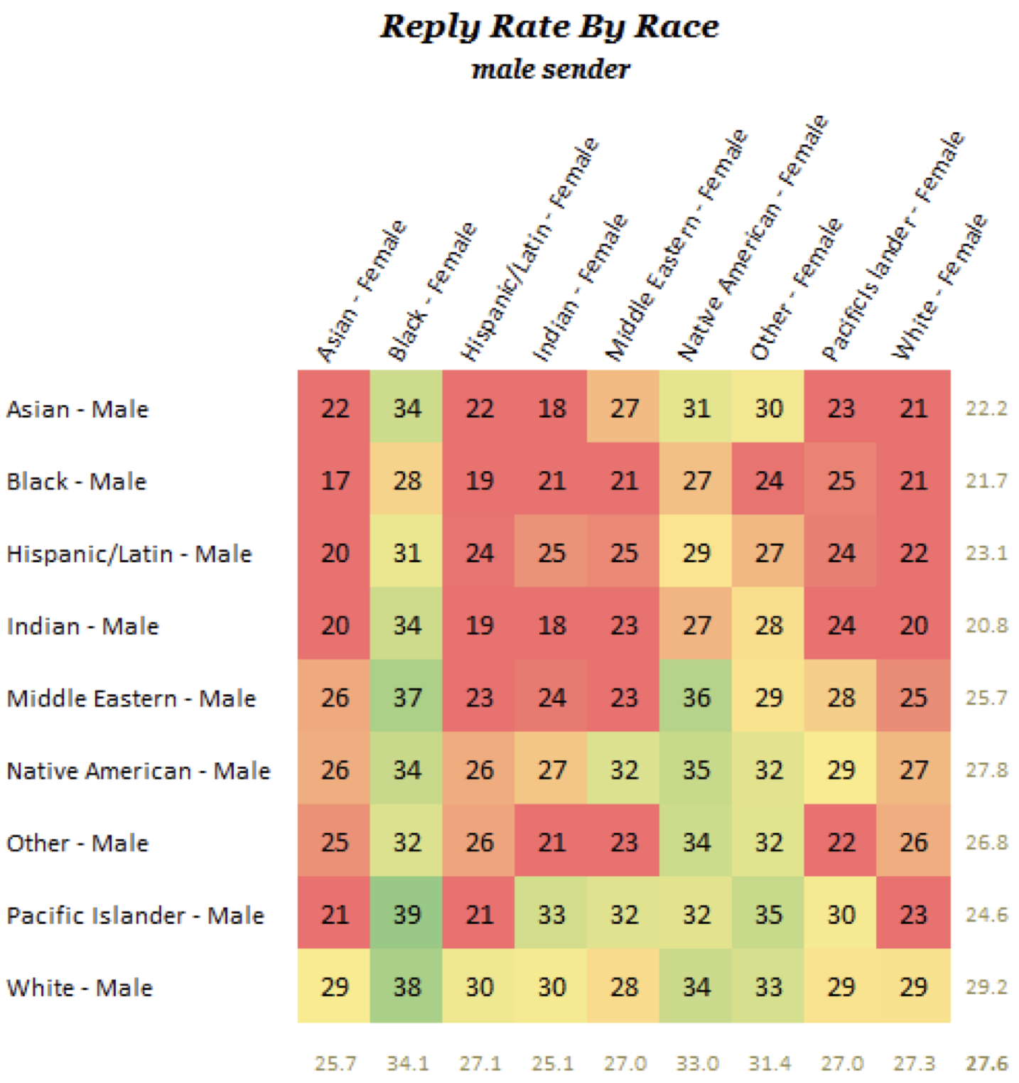

Slide 43
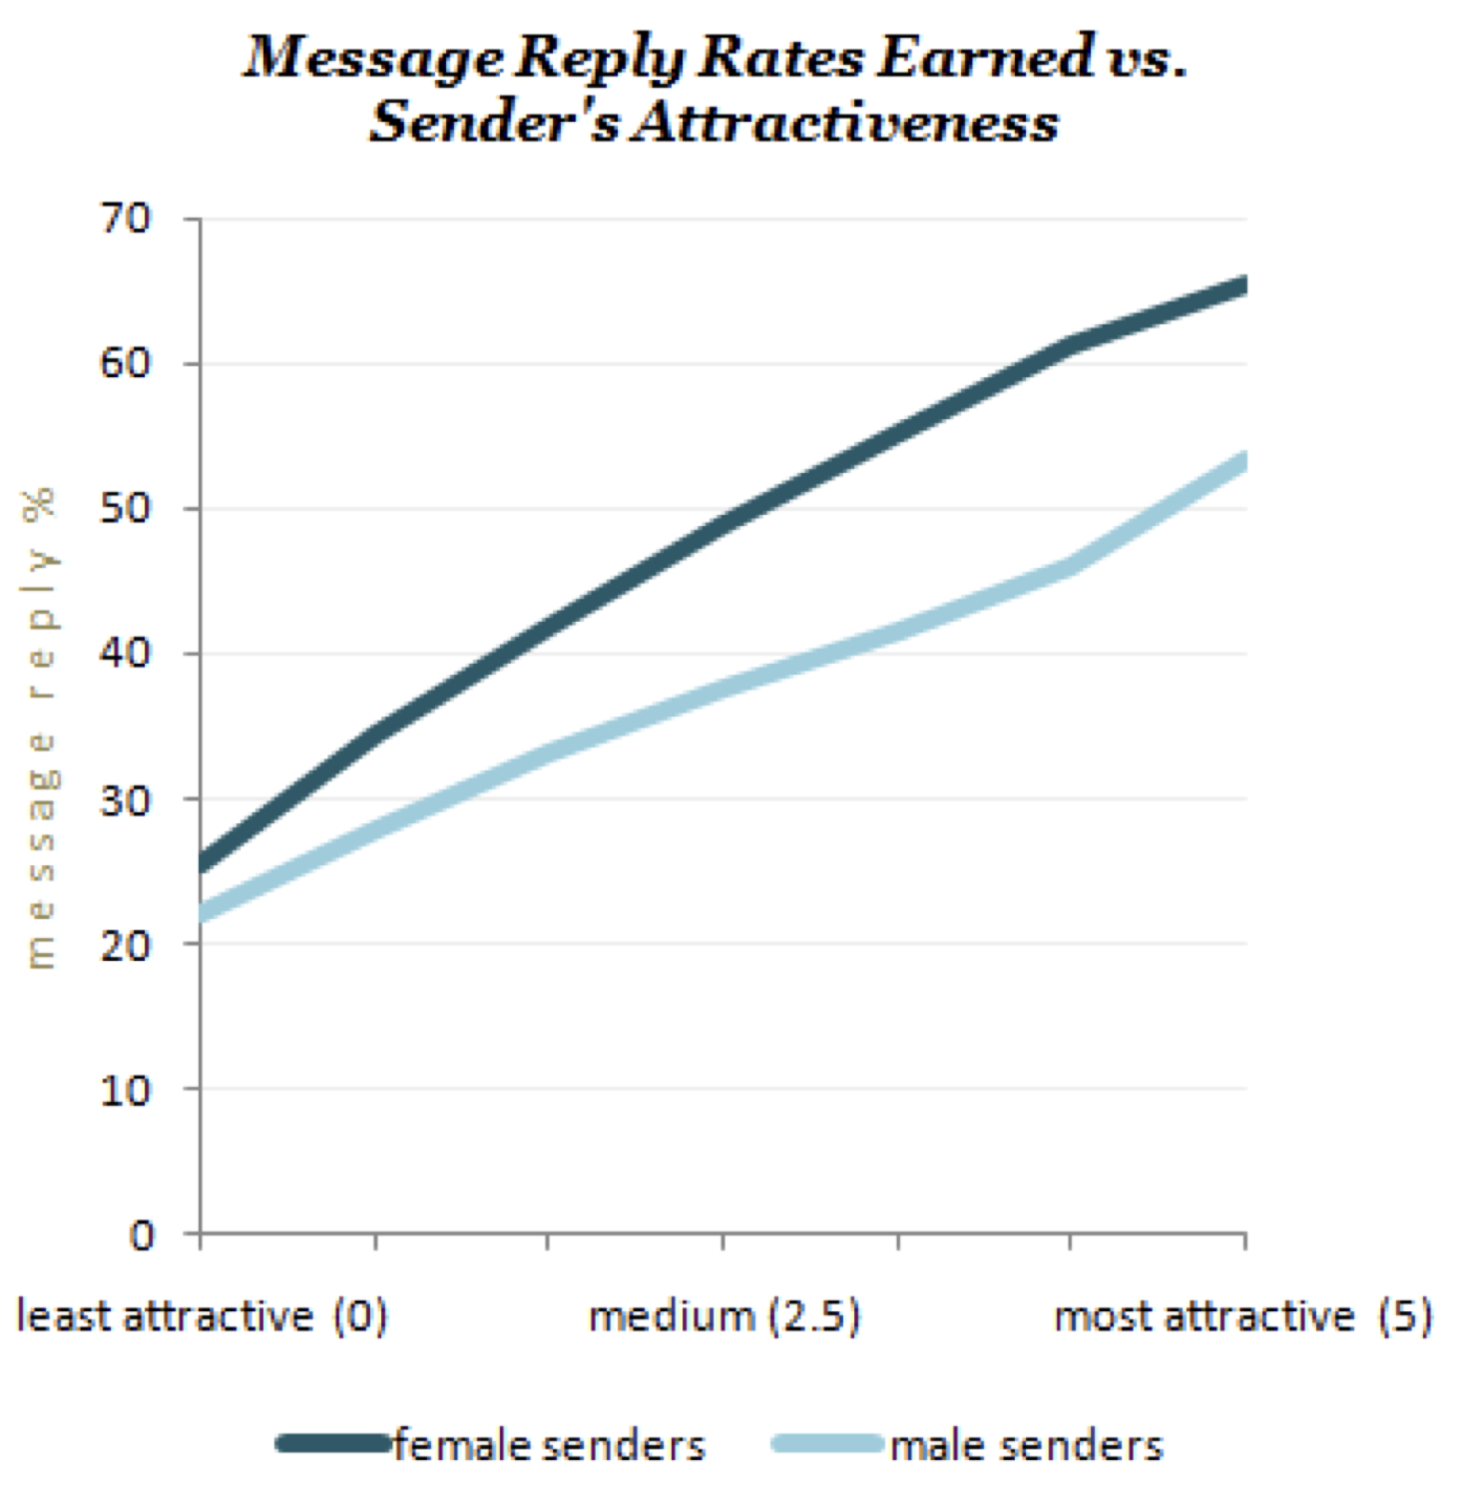

Slide 44
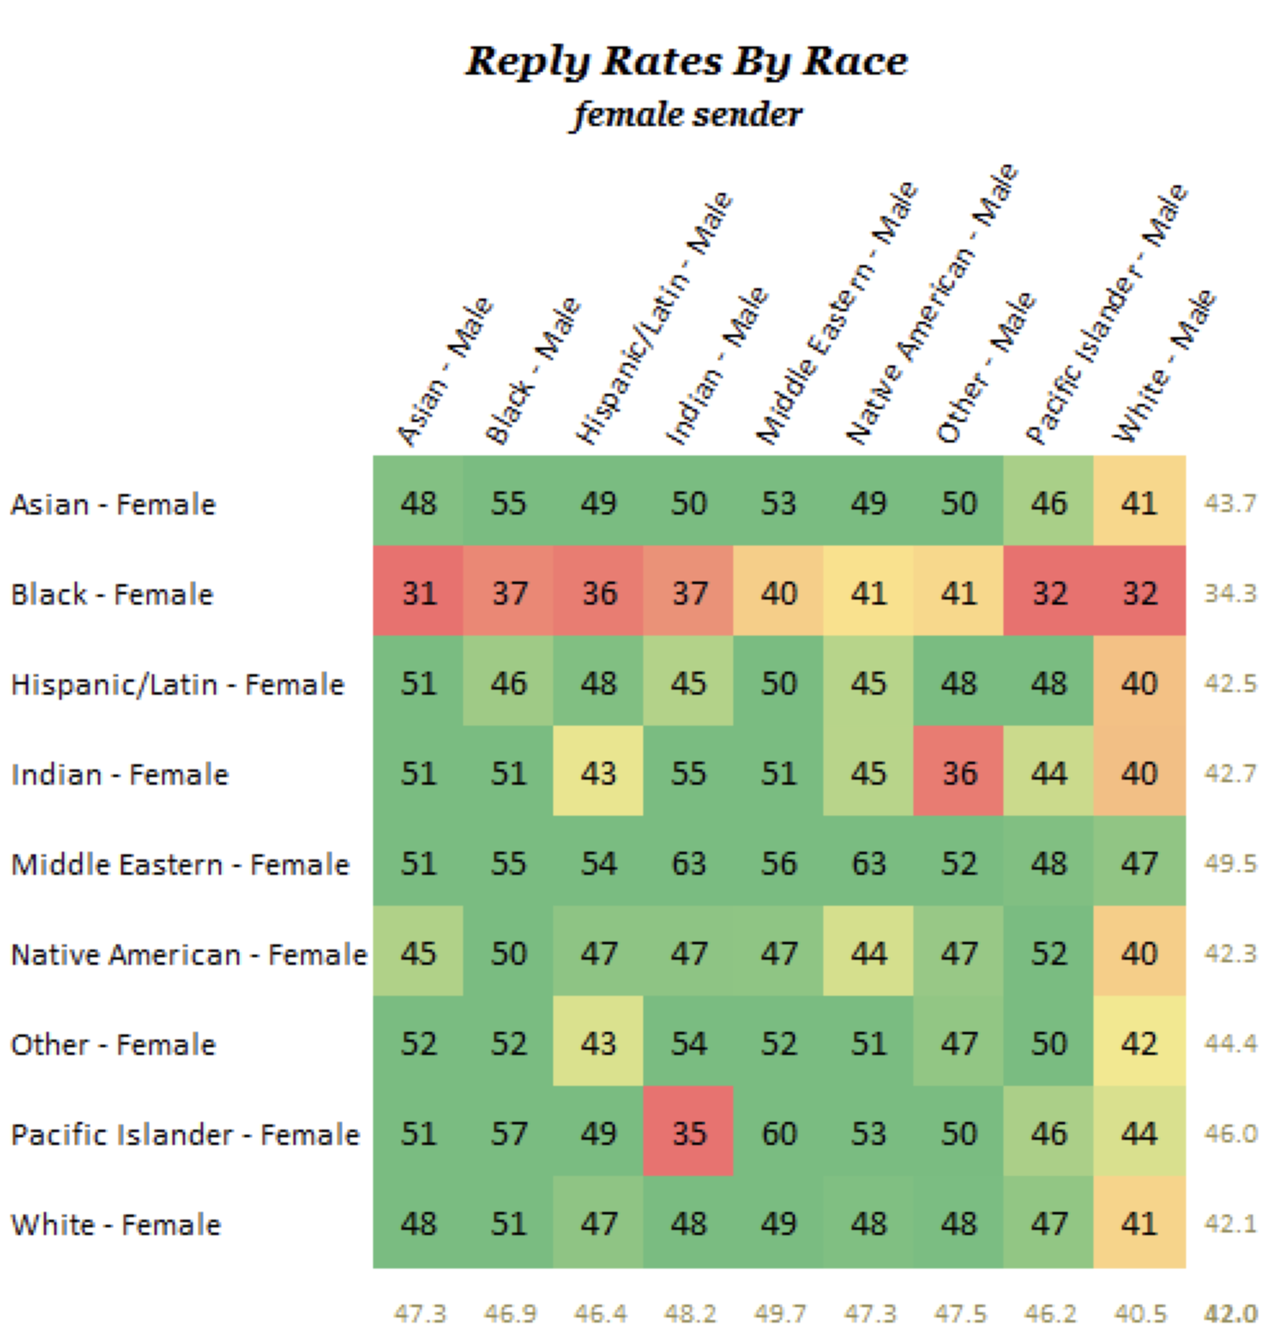
Notes:
Men don’t write black women back
White guys respond less overall

Slide 45
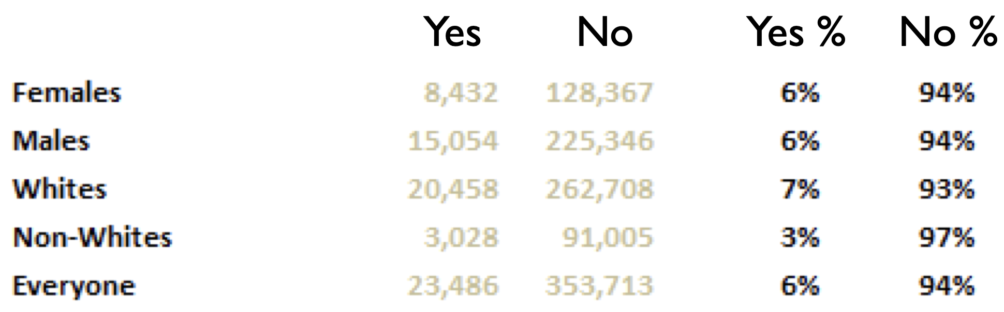
Do you think interracial marriage a bad idea?

Slide 46
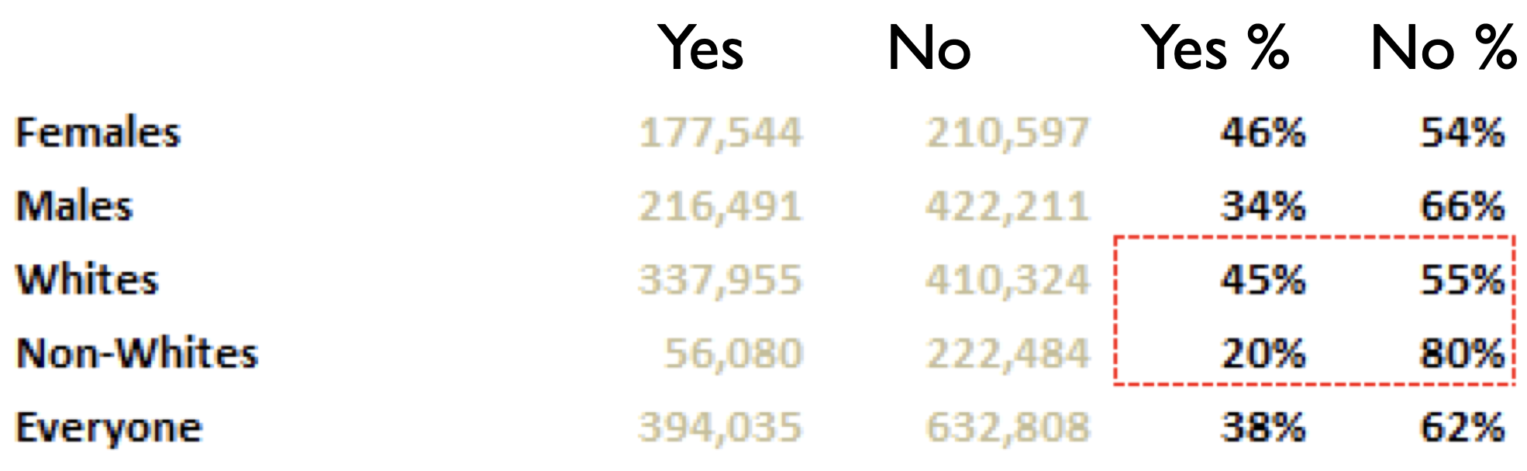
Would you strongly prefer to date someone of your own racial background?

Slide 47
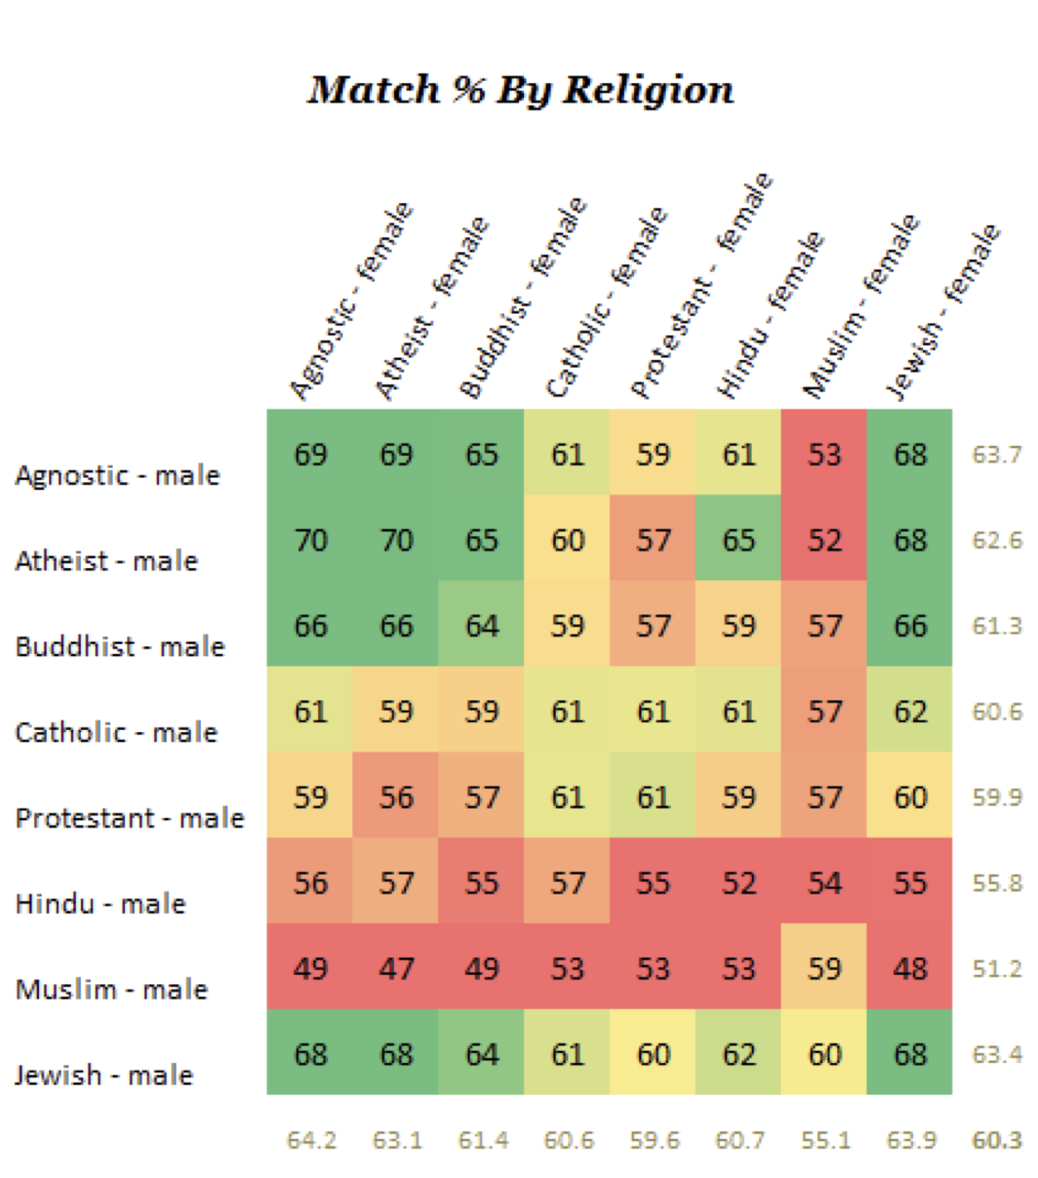

Slide 48
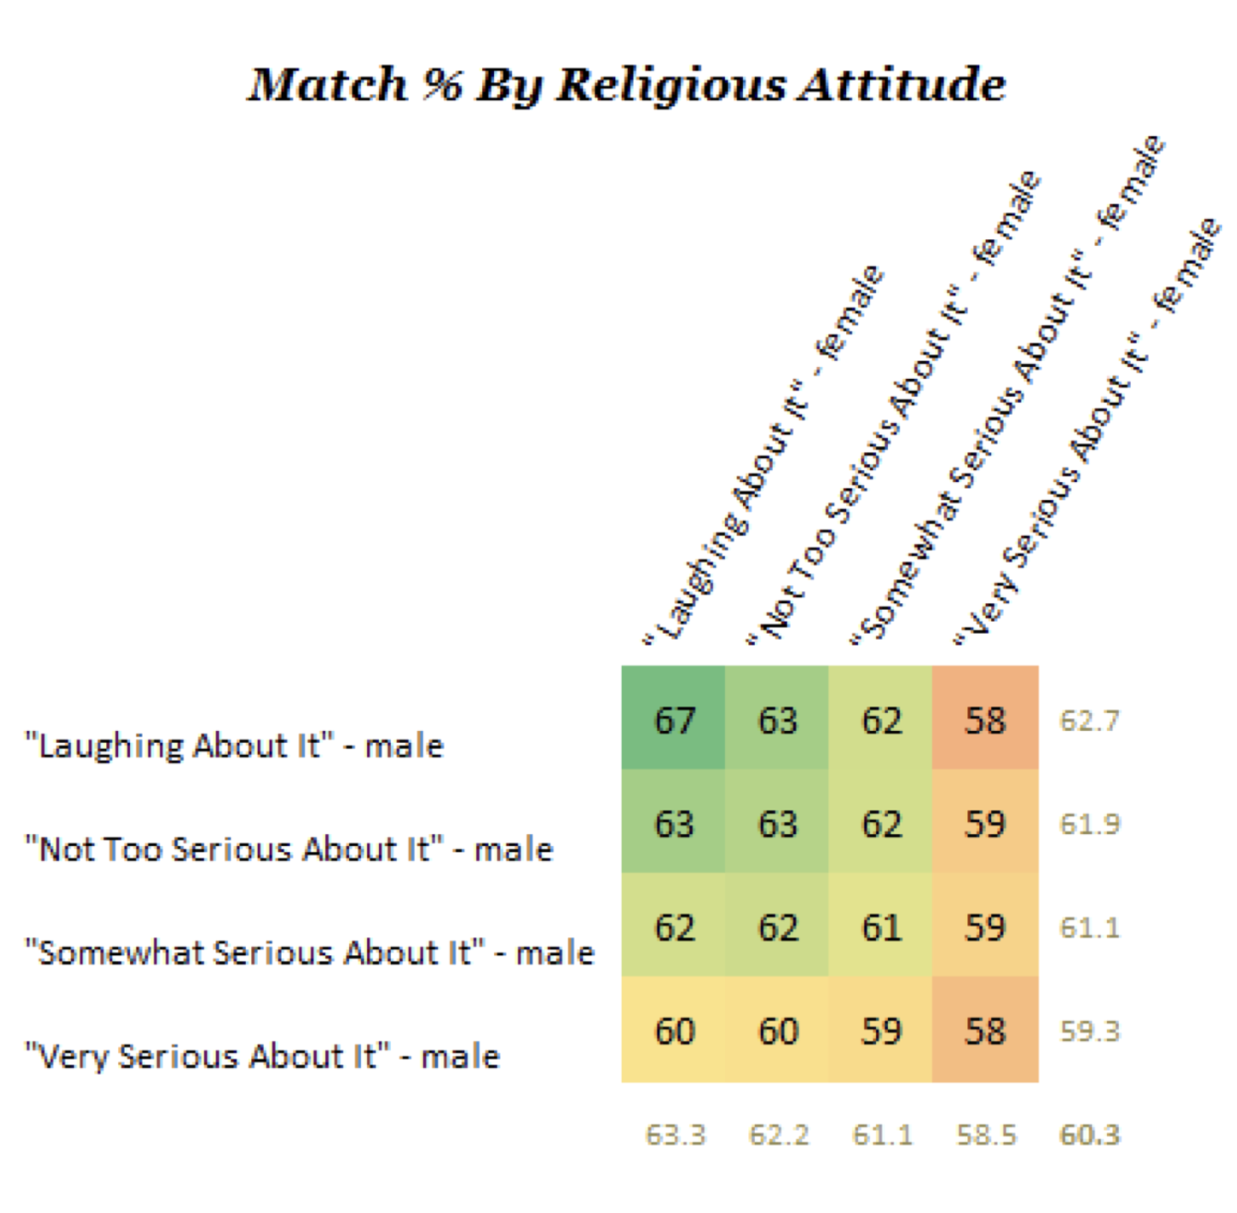

Slide 49
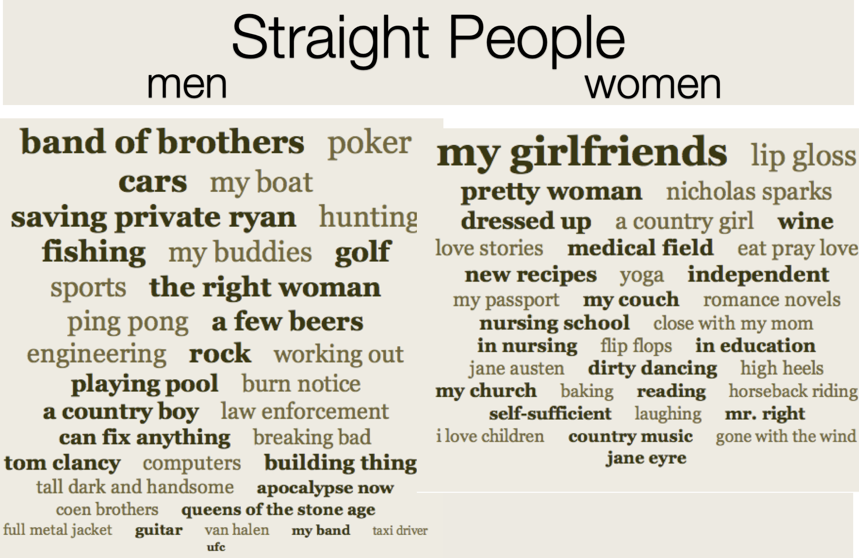

Slide 50
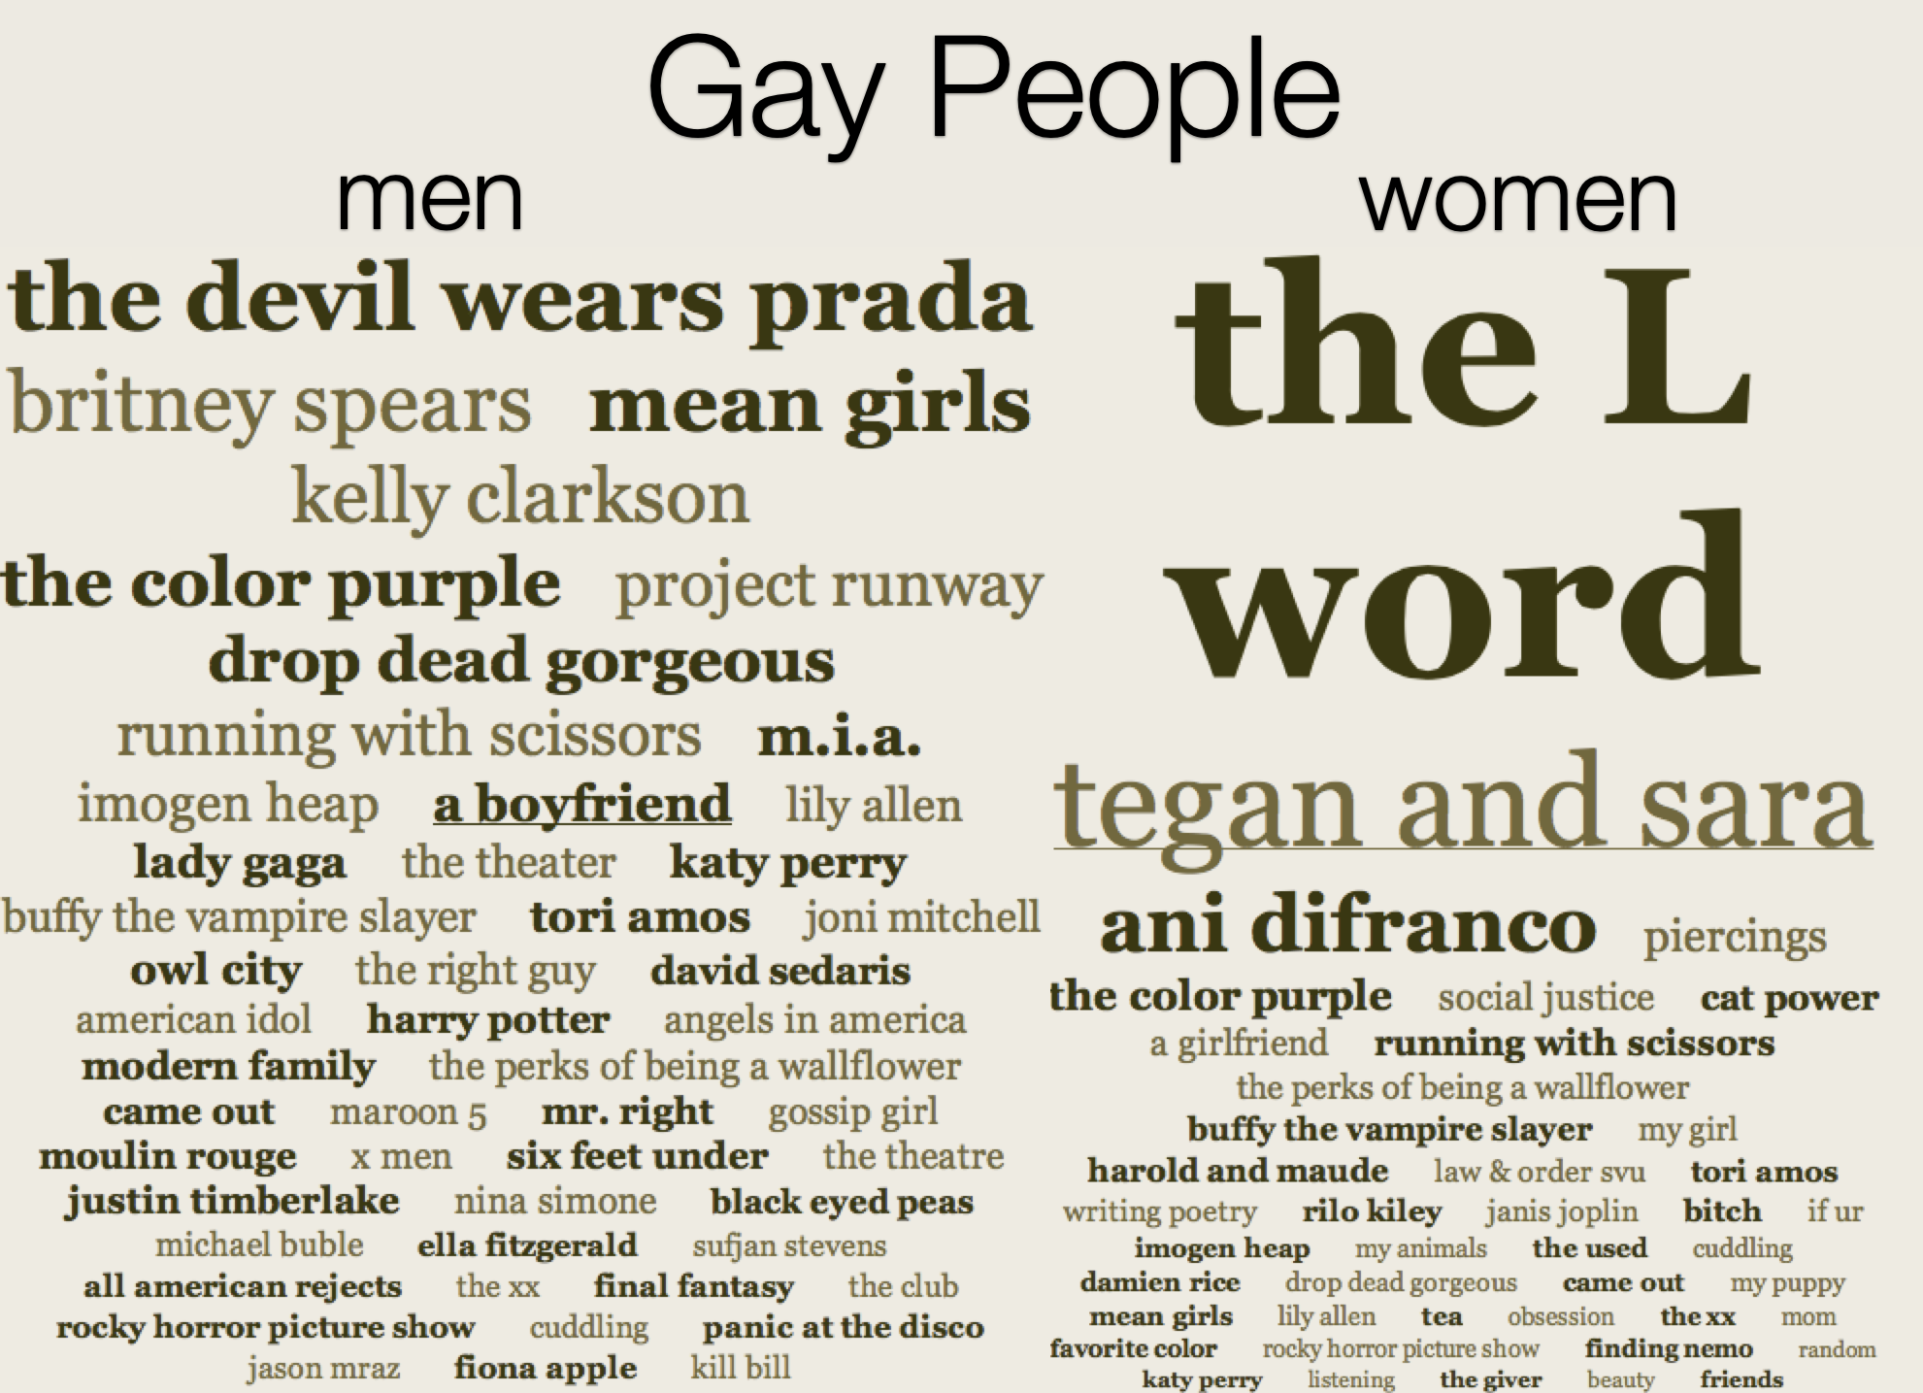

Slide 51
Misconceptions about Gay People
Gay people more promiscuous that straight people
Gay people want to convert straight people
Gay people shouldn’t be allowed to teach in our schools

Slide 52
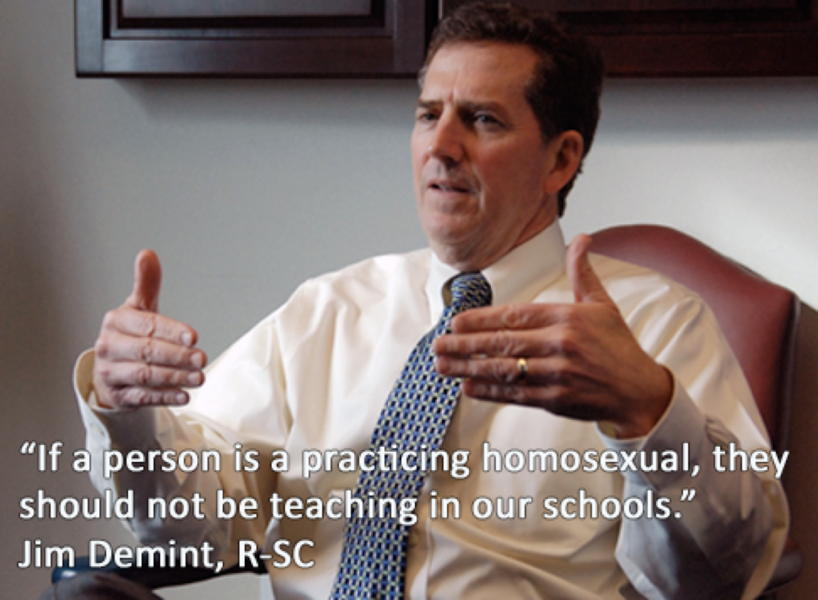

Slide 53
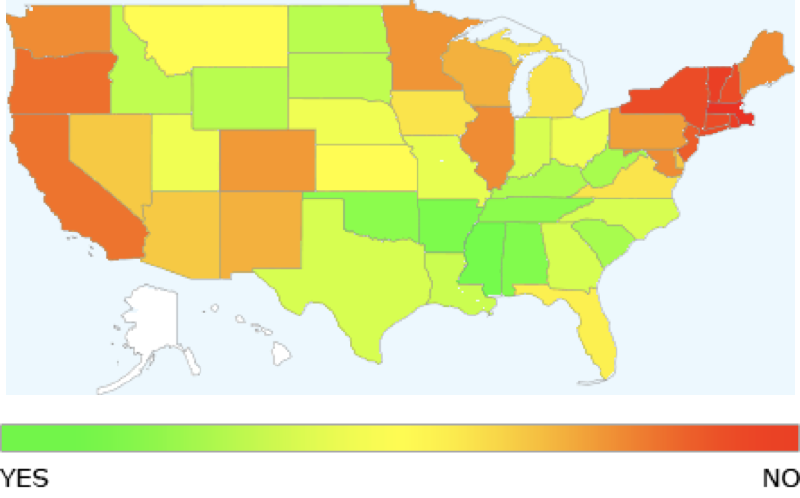
Is homosexuality a sin?

Slide 54
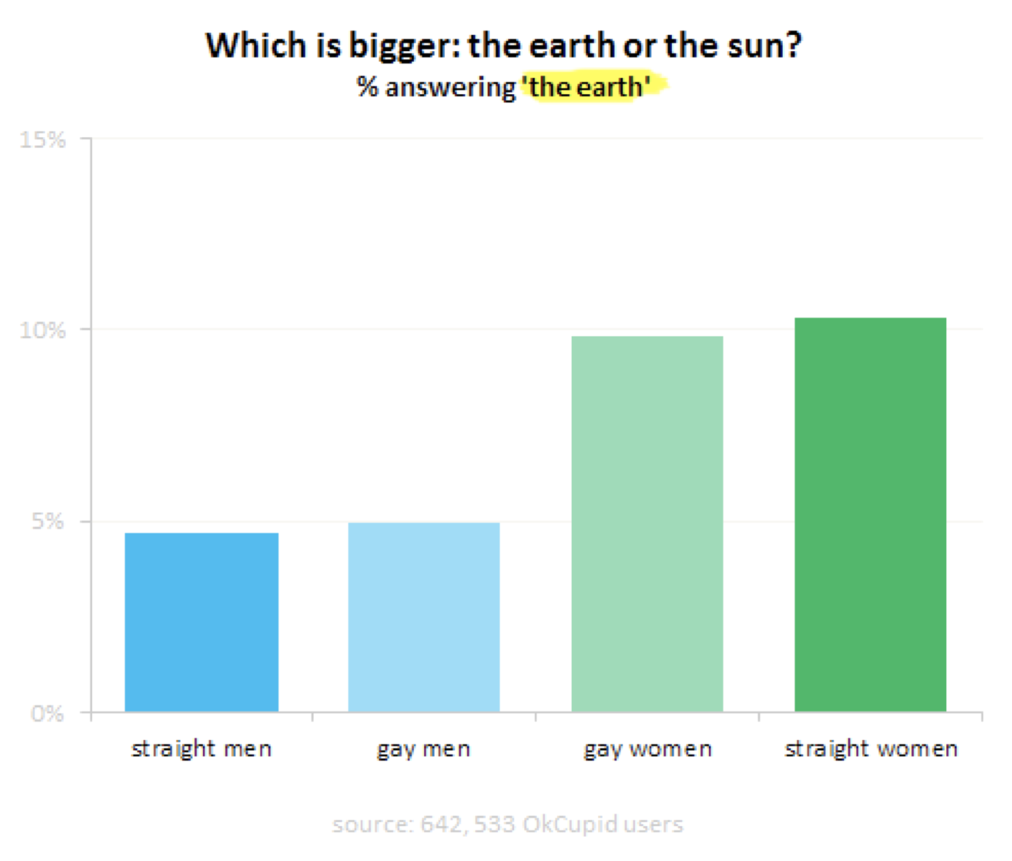

Slide 55
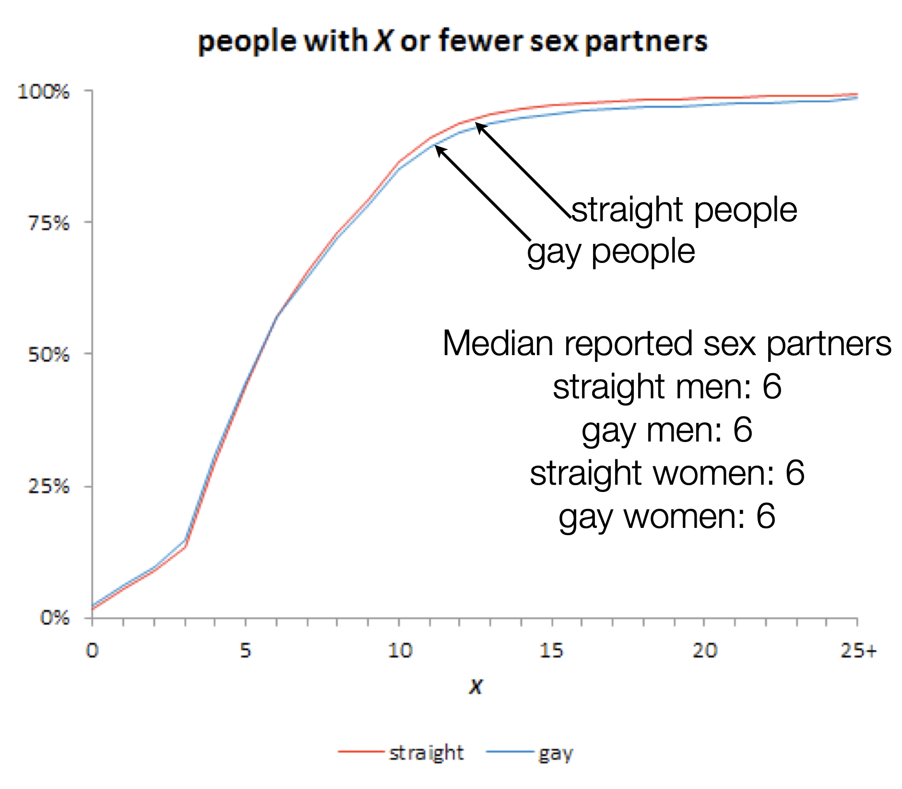

Slide 56
Gay people looking at straight profiles
Only 0.6% of gay men have ever searched for straight matches.
Only 0.1% of lesbians have ever searched for straight matches.
Only 0.13% of straight people's profile visitors are gay.

Slide 57
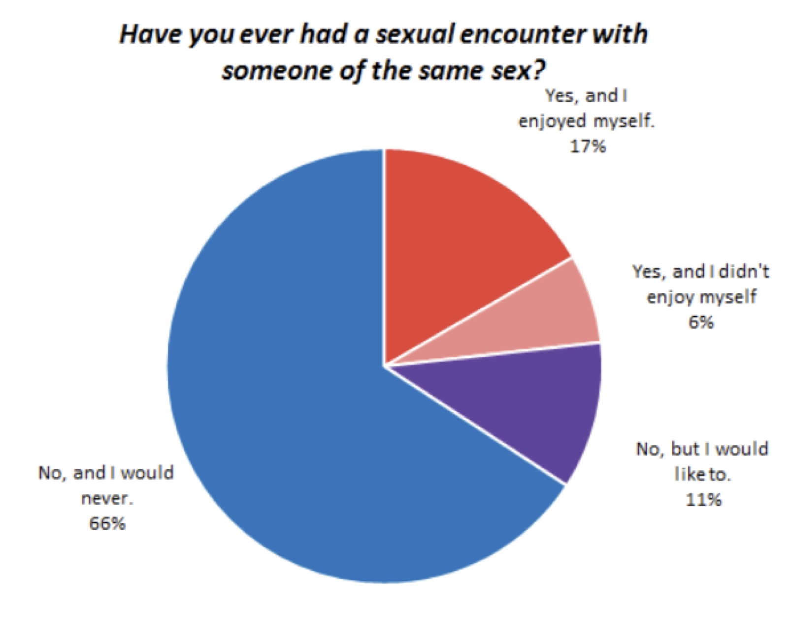
Straight people have gay sex

Slide 58
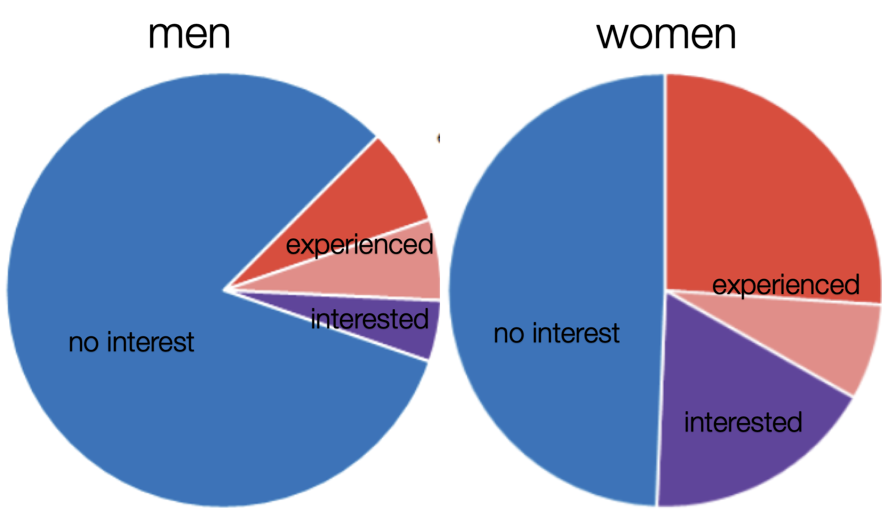
Straight women have gay sex

Slide 59
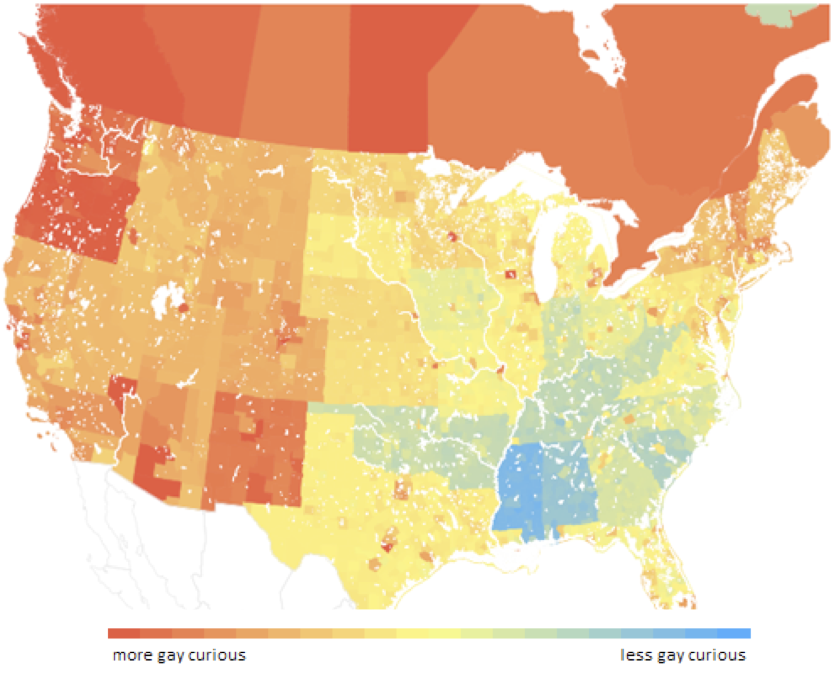
Gay curiositity by region

Slide 60
How to increase your chances
Data analysis can help determine what strategies work best for eliciting a reply
A/B testing for pickup-lines?

Slide 61
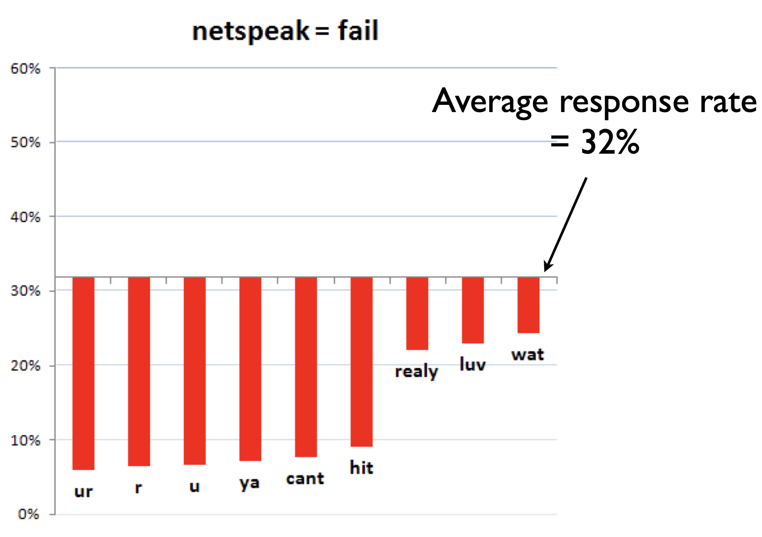
Be Literate

Slide 62
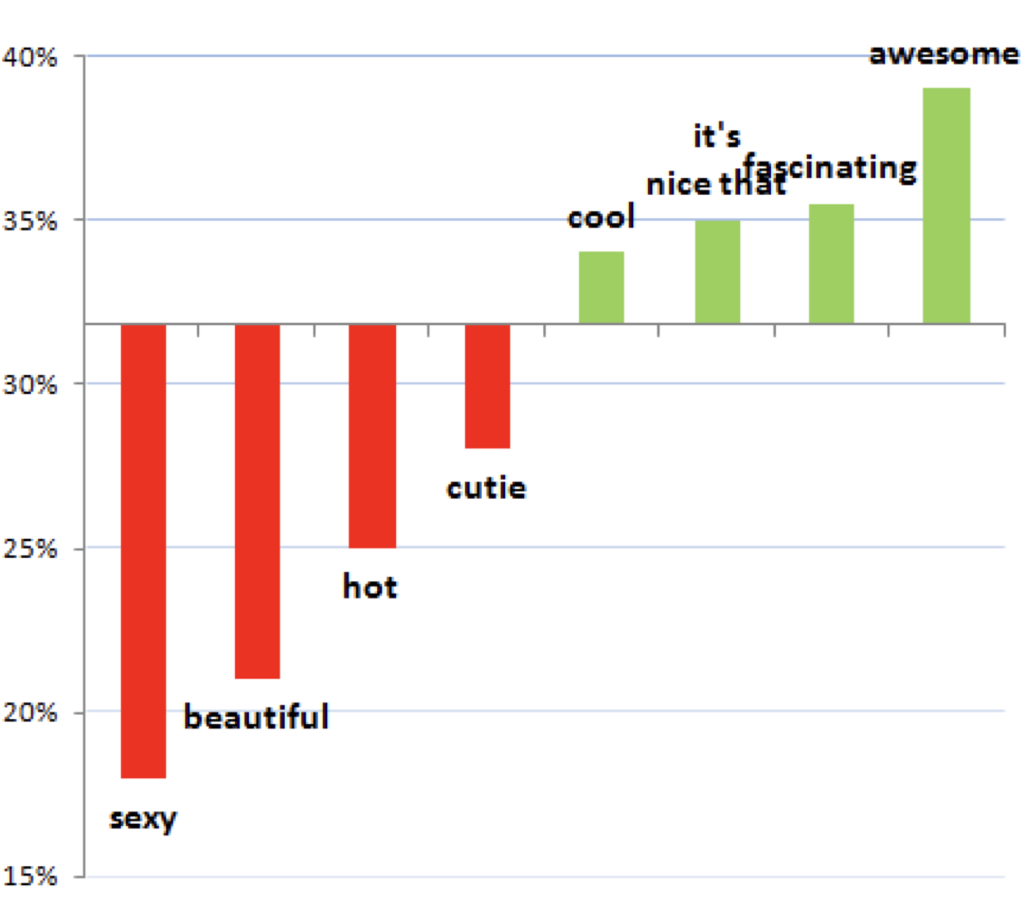
Avoid physical complements

Slide 63
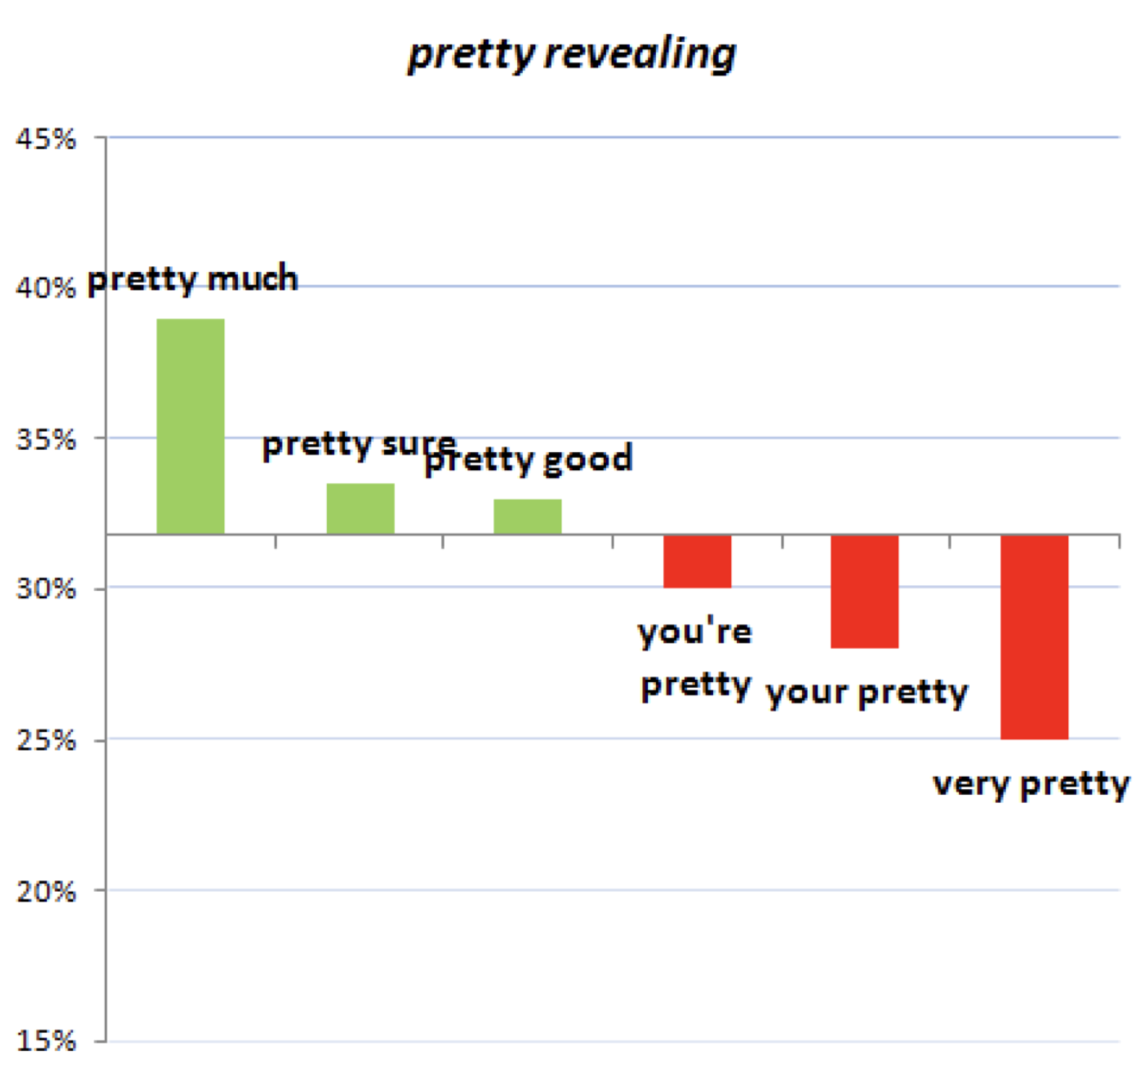
Avoid physical complements

Slide 64
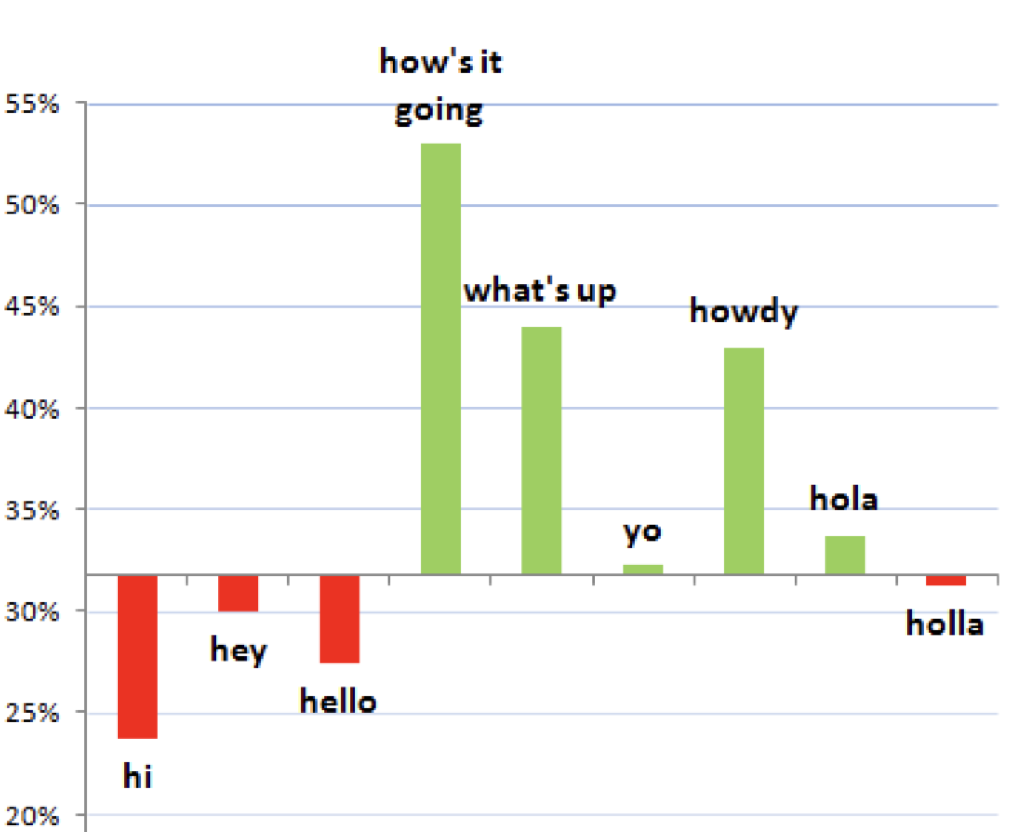
Use Unusual Greetings

Slide 65
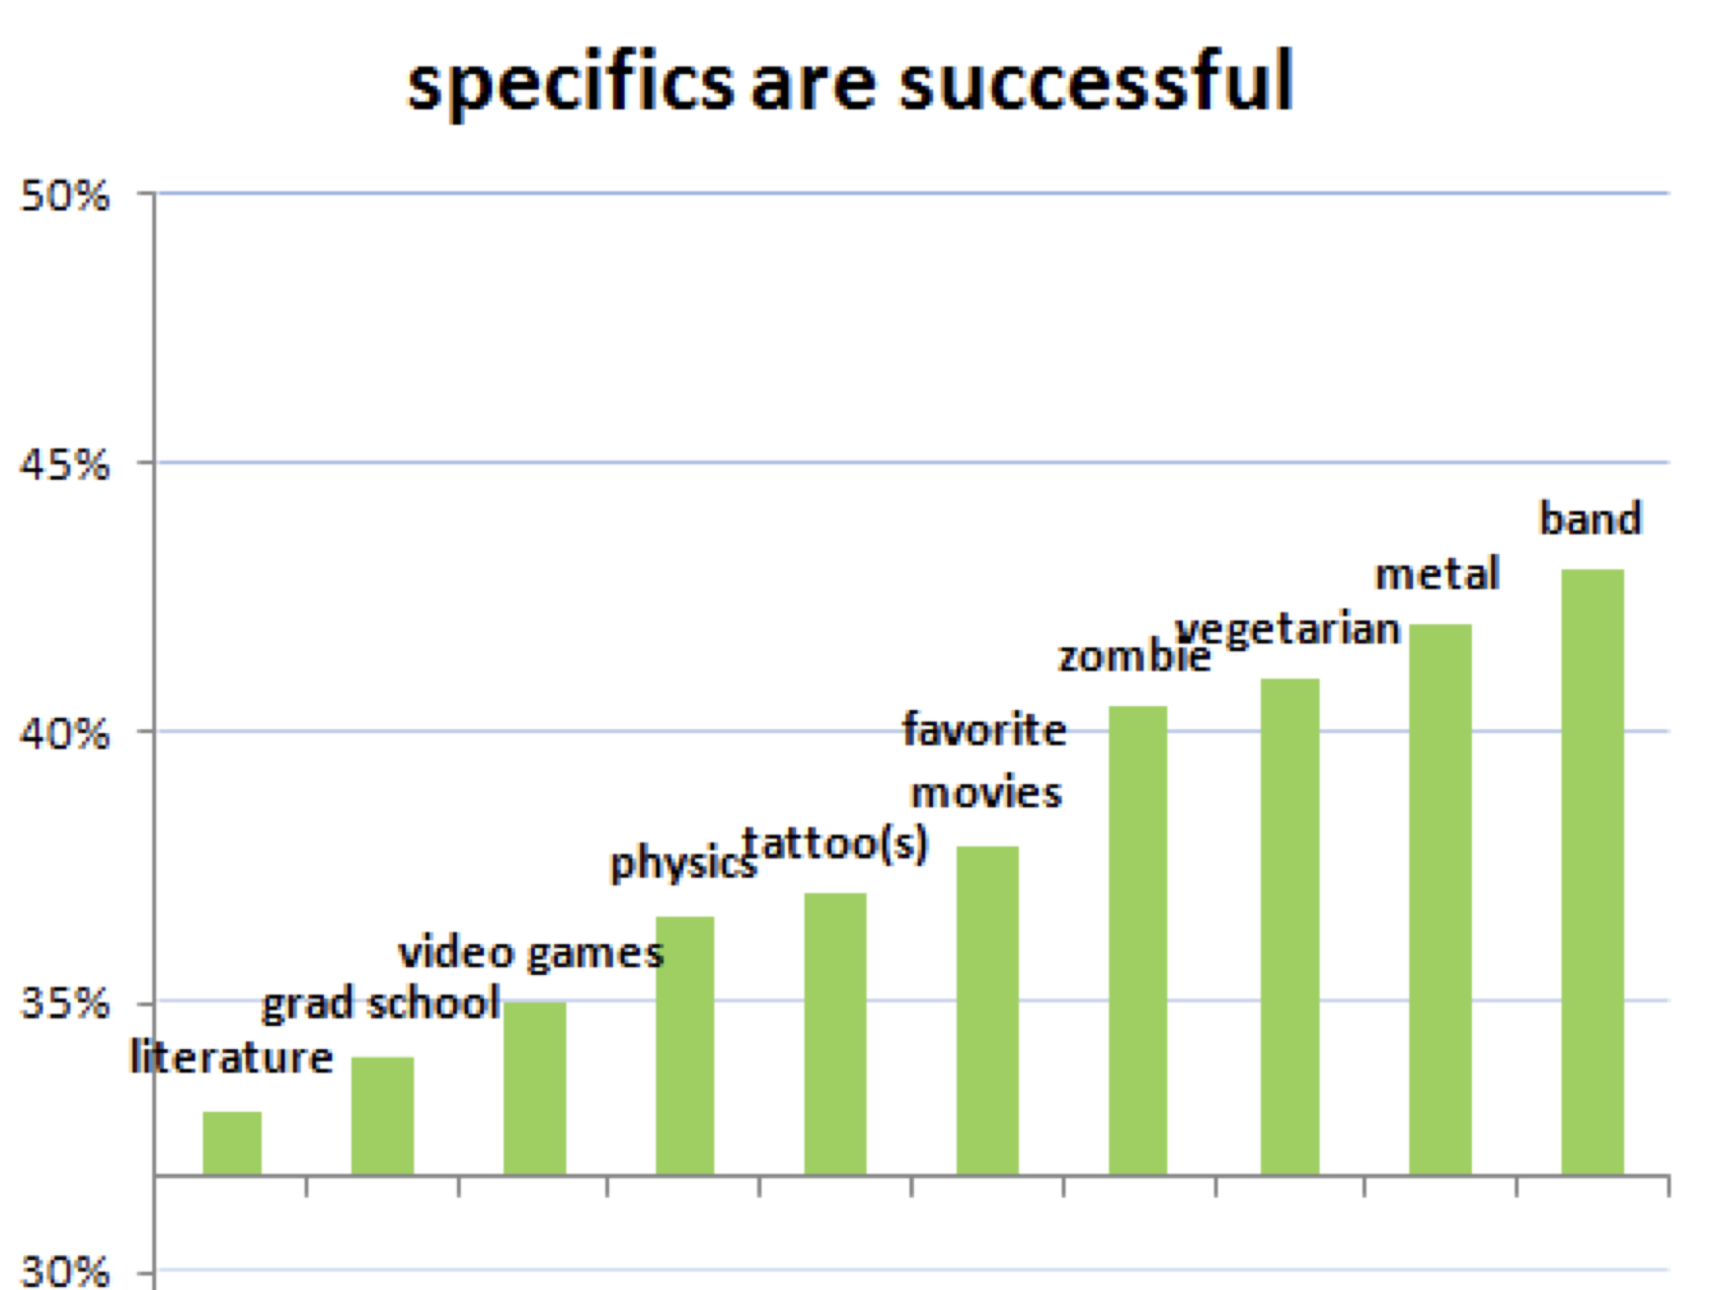
Specifics are successful

Slide 66
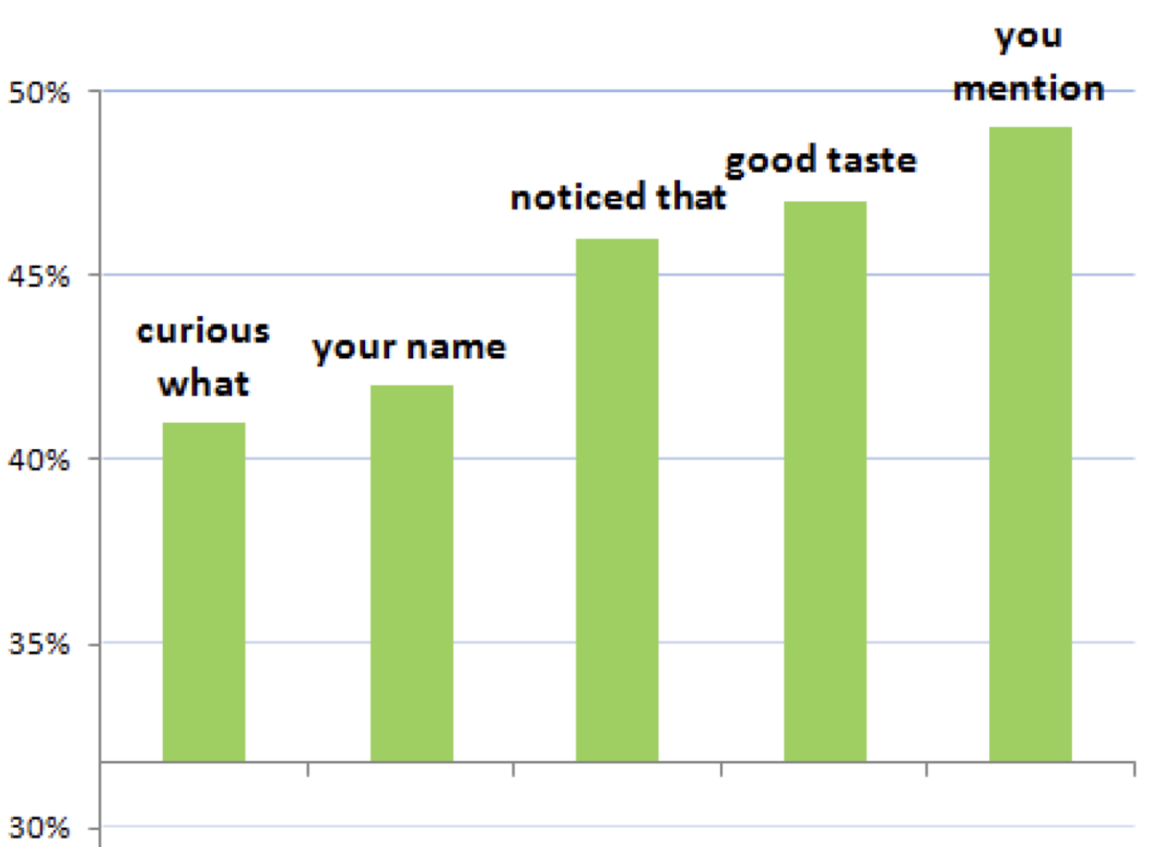
Specific about them

Slide 67
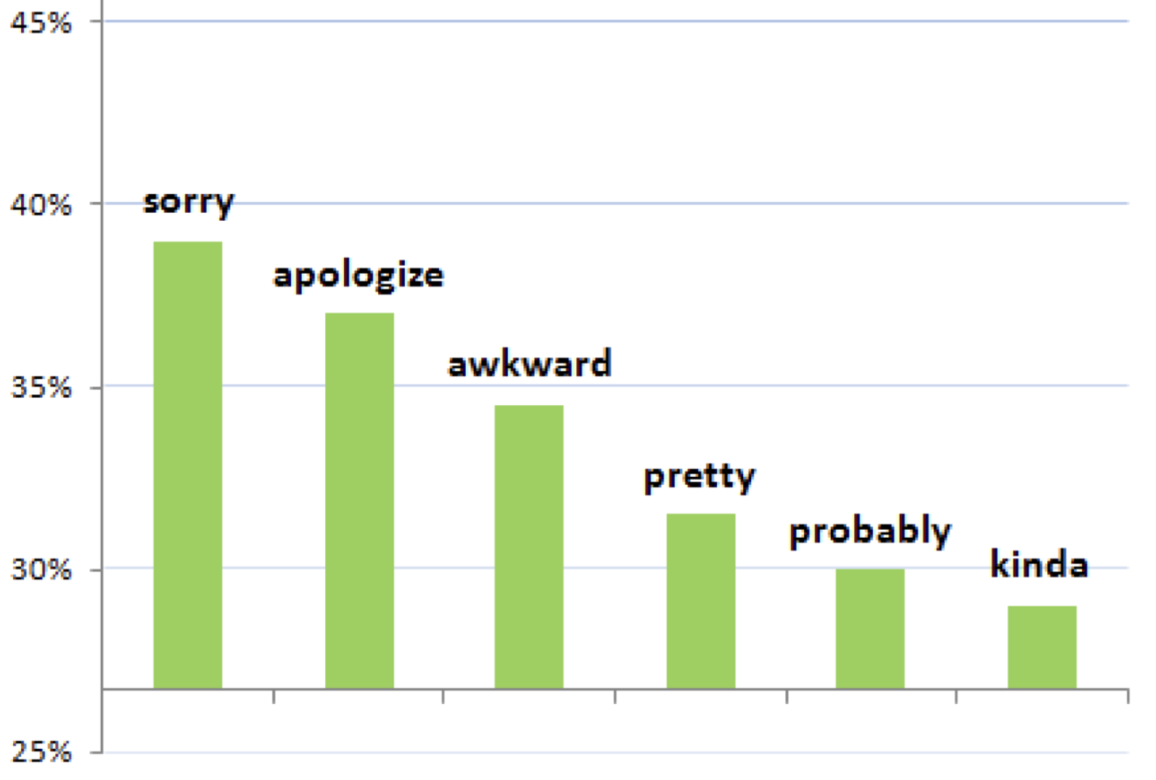
Male self-effacement

Slide 68
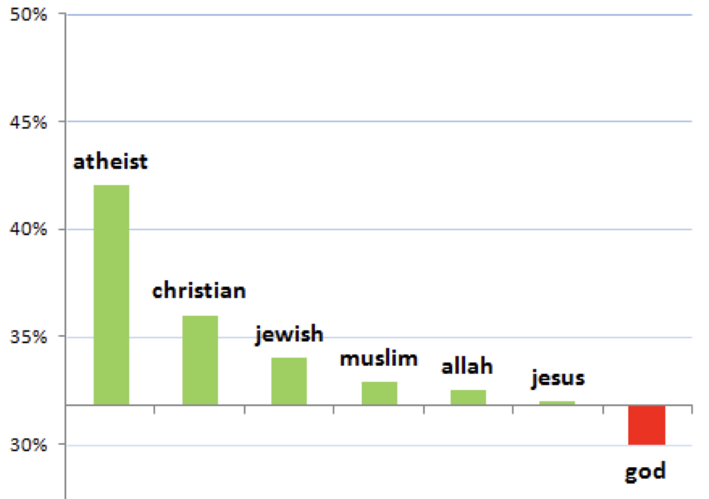
Consider becoming an atheist

Slide 69
Implications
Large numbers of people are willing to disclose information about their attitudes, and beliefs about religion, sex, politics
Incentive: improving the algorithm for matching them up with compatible partners
Side effect: coolest sociological data around

Slide 70
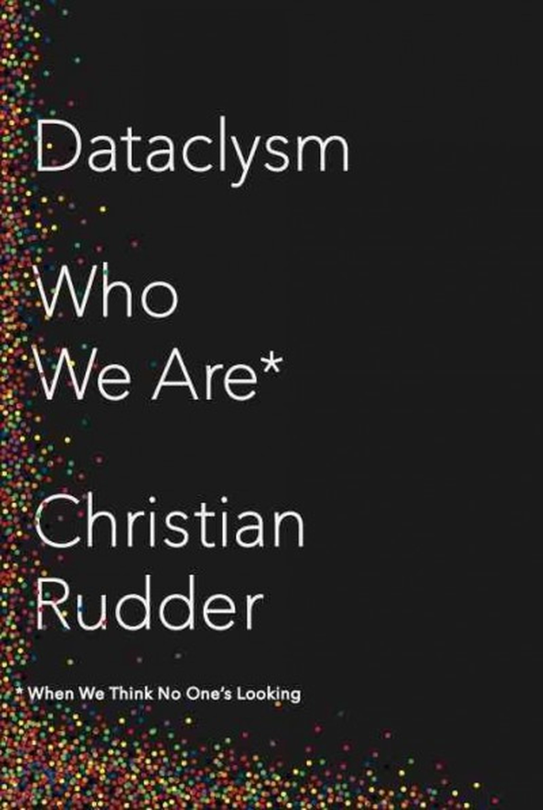

Slide 71
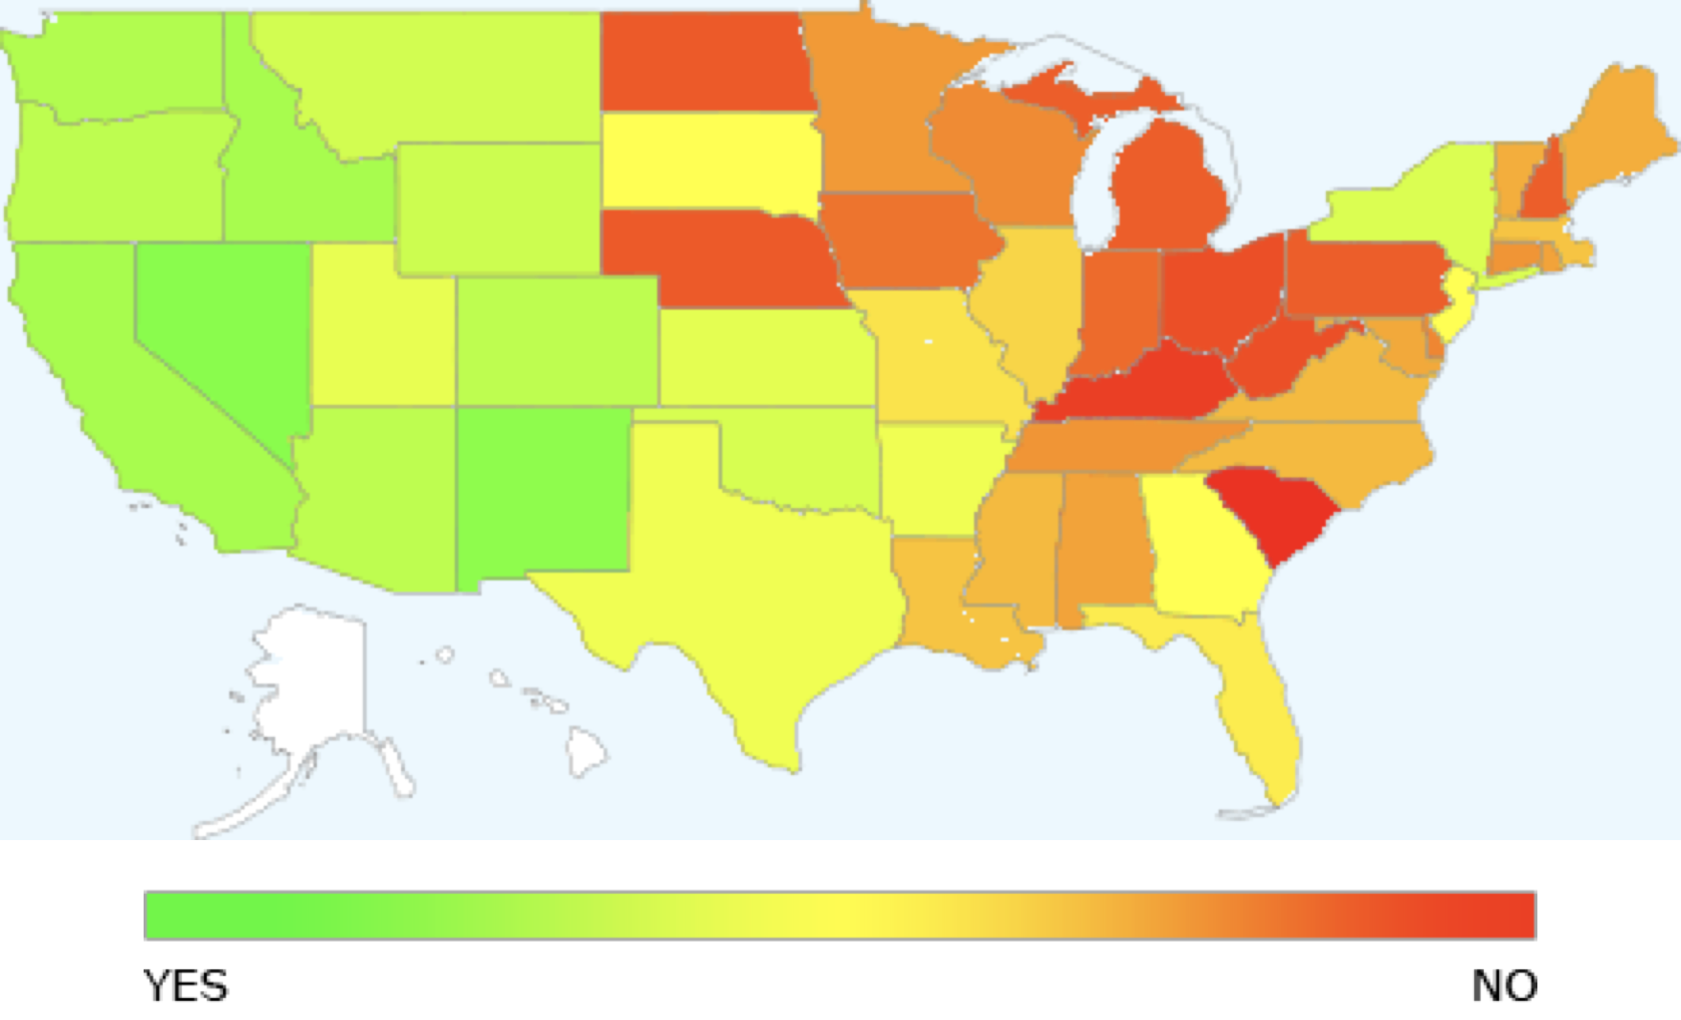
Would you date someone just for sex?

Slide 72
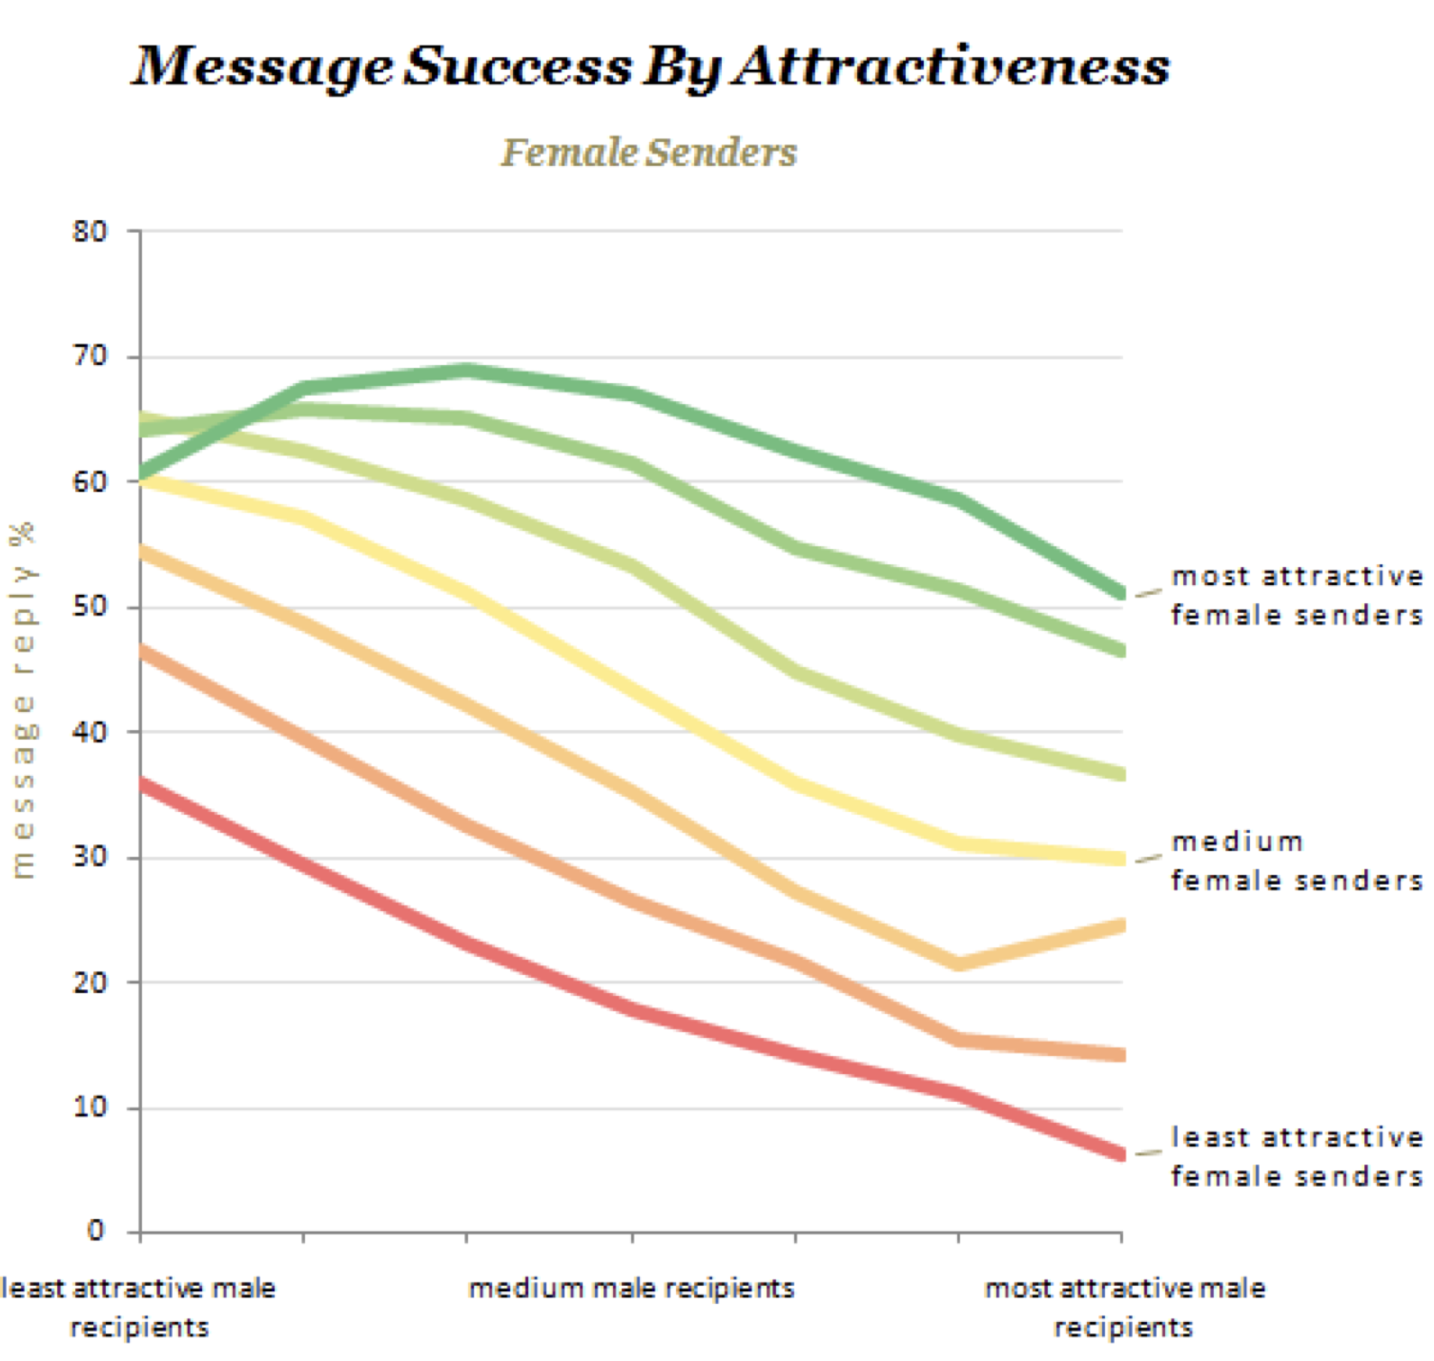

Slide 73
